Slide 1
HISTORY

Slide 2
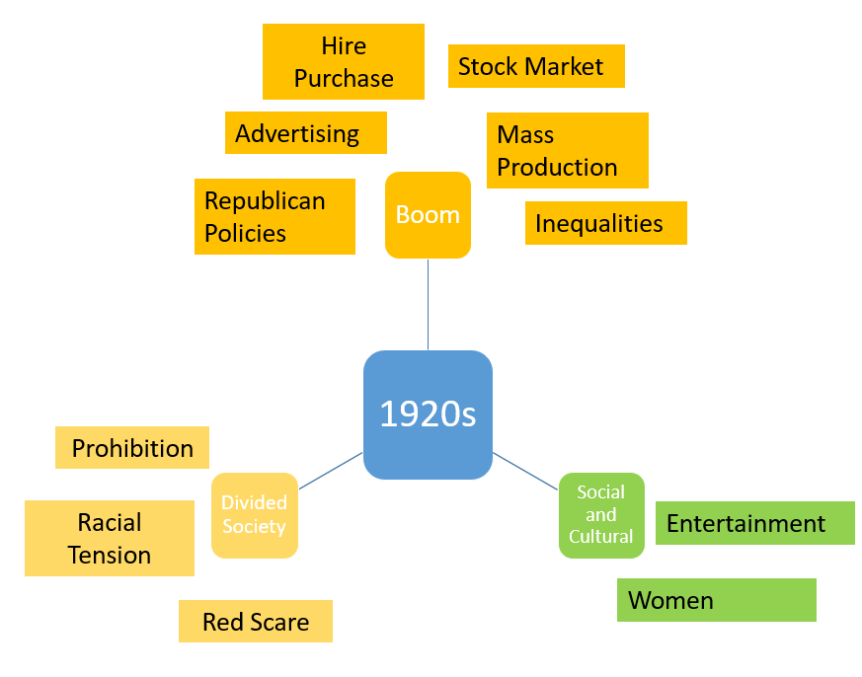
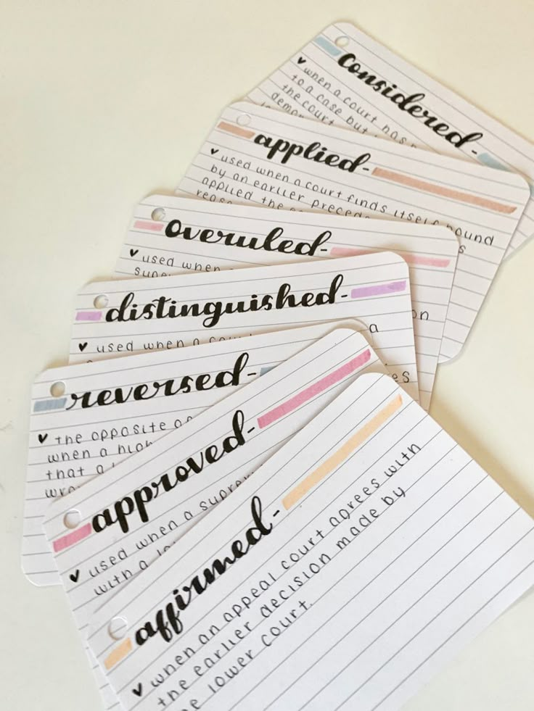
How to revise History: Gathering your knowledge
Subheadings and bullet points
Use me for revising specific detail
Flash cards
Use me for revising specific detail and testing what you know
Mind maps
Use me for revising specific detail
Immigration in the 1920s:
1917 Literacy Act
1921 Emergency Quota Act
1924 Johnson-Reed Act
Write down key words or events on one side
Write down facts about the event on the other
Test yourself!
Top tip: Try teaching yourself, your family/friends or even your pet about the topic you are revising
If you can teach it without using your notes, you understand it and are ready to move on!

Slide 3

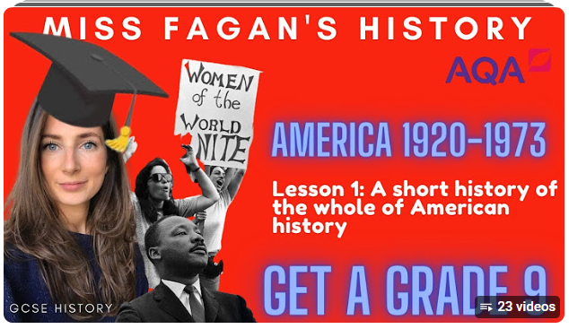
How to revise History: online lessons
Oak Academy
Youtube
Miss Fagan’s History
Top tip: Oak Academy has lessons and activities on all of our GCSE topics. Google ‘Oak Academy’ and the topic you want to cover for a full online lesson!

Slide 4
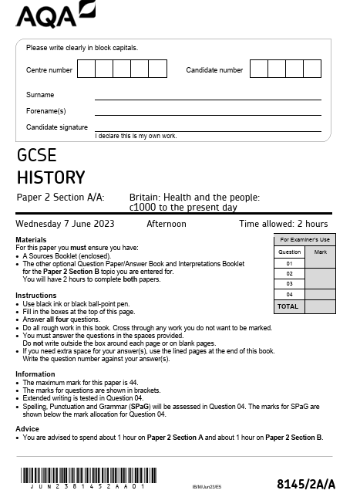
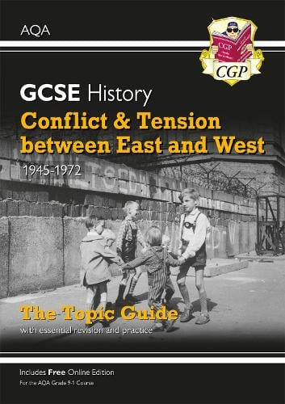
How to revise History: Applying your knowledge
Revision guide tasks
Use your revision guide to complete the activities and exam style questions.
Answers are in the back so you can check your work! Do this after you’ve had a go at the question on your own
Quiz yourself
For each topic, make your own end of topic fact test
Write 5 questions and have the answers ready today
Tomorrow, try the questions without looking at yesterday’s work
If you can answer them, your revision worked and it’s time to move on!
Past papers
Look online or ask your teacher for past papers to practice
Your
teachers
will
mark
them if
you do
them!

Slide 5
History exams
There are two exam papers in History.
Top tip: For every 4 marks in the question, spend 5 minutes and write one paragraph
4 marks = 5 mins, 1 paragraph
8 marks = 10 mins, 2 paragraphs
12 marks = 15 mins, 3 paragraphs
16 marks = 20 mins, 4 paragraphs
Paper 1: 16th May | Paper 2: 5th June
USA 1920 – 1973 Opportunity and Inequality Cold War 1945-1972 | Medicine 1000AD – Present Day Norman England 1066 – 1100

Slide 6
Paper 1: 16th May
Paper 2: 5th June
USA: Opportunity and Inequality
1920s: Boom
1930s: Depression
1940s: War
1950s: Post war
1960s: Civil Rights, JFK, LBJ and Women
1970s: Civil Rights and Women
Cold War
1940s: Start of Cold War
1950s: Thaw, Arms/Space Race
1960s: Crises
1970s: Detente
Medicine 1000AD-Present Day
Medieval
Renaissance: change
Industrial
Modern
Normans 1066-1100
Conquest and control
Norman life
Norman religion
Durham Cathedral

Slide 7
USA | Cold War | Medicine | Normans
Question 1: Content Question 2: Provenance and content Question 3: Own knowledge Question 4: Own knowledge Question 5: Own knowledge Question 6: own knowledge | Question 1: Content and provenance Question 2: Content and provenance Sources limited individually, useful together Question 3: Own knowledge Question 4: Own knowledge | Question 1: Content and provenance Question 2: Own knowledge Question 3: Own knowledge Question 4: 3 time periods 2 factors 1 conclusion | Question 1: Content Question 2: Own knowledge Question 3: Own knowledge Question 4: Own knowledge Durham Cathedral Architecture Location Key individuals Religious function

