Slide 1

Year 9 Options Evening
21st January 2025

Slide 2
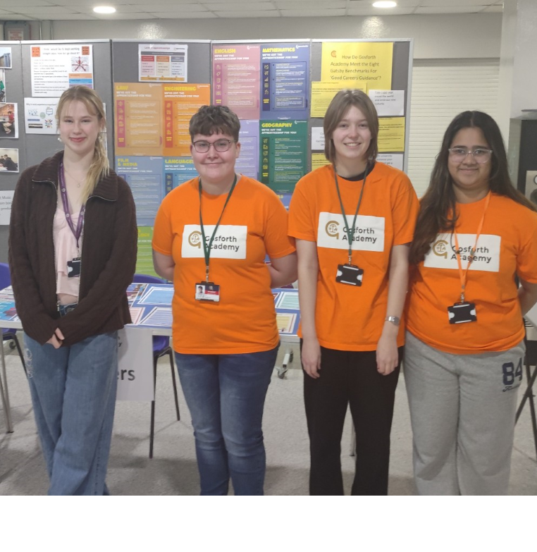

Guiding students on career choices
Our Year 12 Options Evening is designed to introduce students to various career paths and guide them in making informed decisions about their future after school.
At the event, our Sixth Form Student Union Wellbeing Officer, Kerry Jameson, was joined by three Year 12 student volunteers. They assisted parents by directing them to the right stalls and answering questions about their experiences in school.
Deciding on options can be challenging, as many students are uncertain about their future aspirations. To support students and parents in this process, we distribute a newsletter containing information about careers and share resources that can help students make informed choices.
For more information, please visit the Gosforth Academy Careers page on our website or search for the Careers page on Frog.
For students who are still feeling uncertain, support is available in The Progression Hub (Room 156) from Mrs. Carter and Mr. Limbrick, our Careers Leaders. Additionally, assistance is provided by the Careers & Guidance Team at Newcastle City Council.
Create Your Future

Slide 3
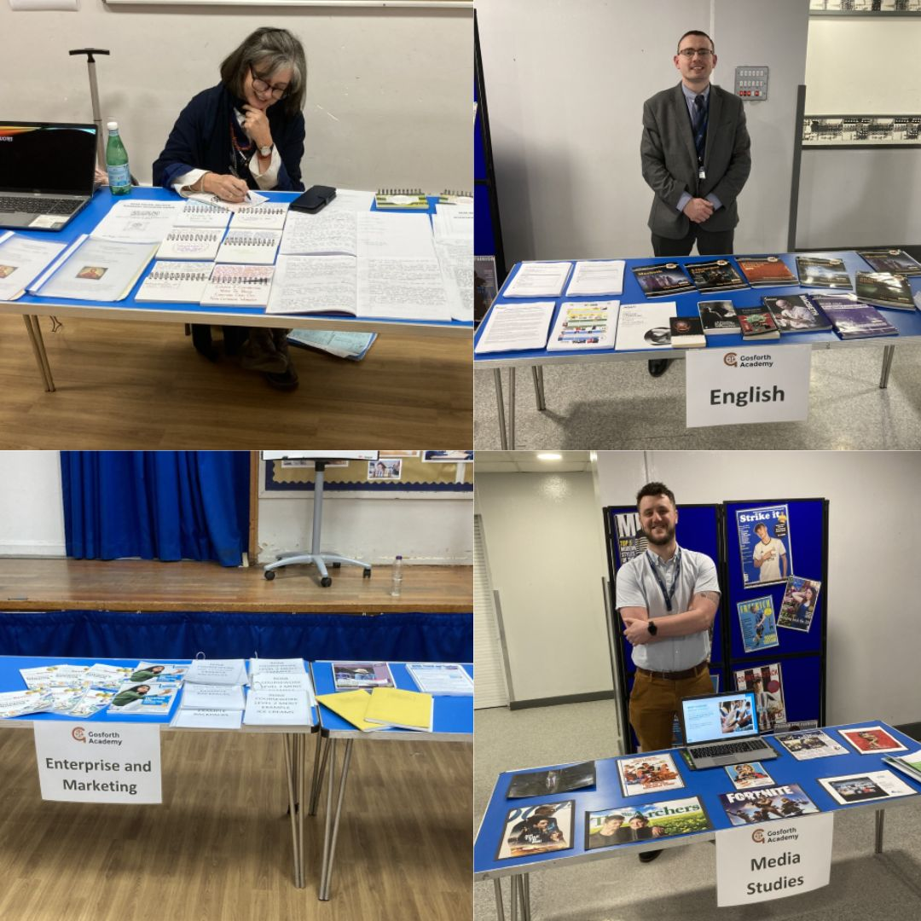
Useful Links: Business, RE, Media Studies & English
Useful links to subject areas and potential career options in Business, RE, Media Studies and English:
https://www.prospects.ac.uk/job-profiles/browse-sector/business-consulting-and-management
https://www.prospects.ac.uk/careers-advice/what-can-i-do-with-my-degree/english
https://www.prospects.ac.uk/careers-advice/what-can-i-do-with-my-degree/media-studies
https://www.prospects.ac.uk/careers-advice/what-can-i-do-with-my-degree/theology-and-religious-studies
https://findapprenticeshiptraining.apprenticeships.education.gov.uk/courses?keyword=business
https://www.tlevels.gov.uk/students/subjects
Create Your Future

Slide 4
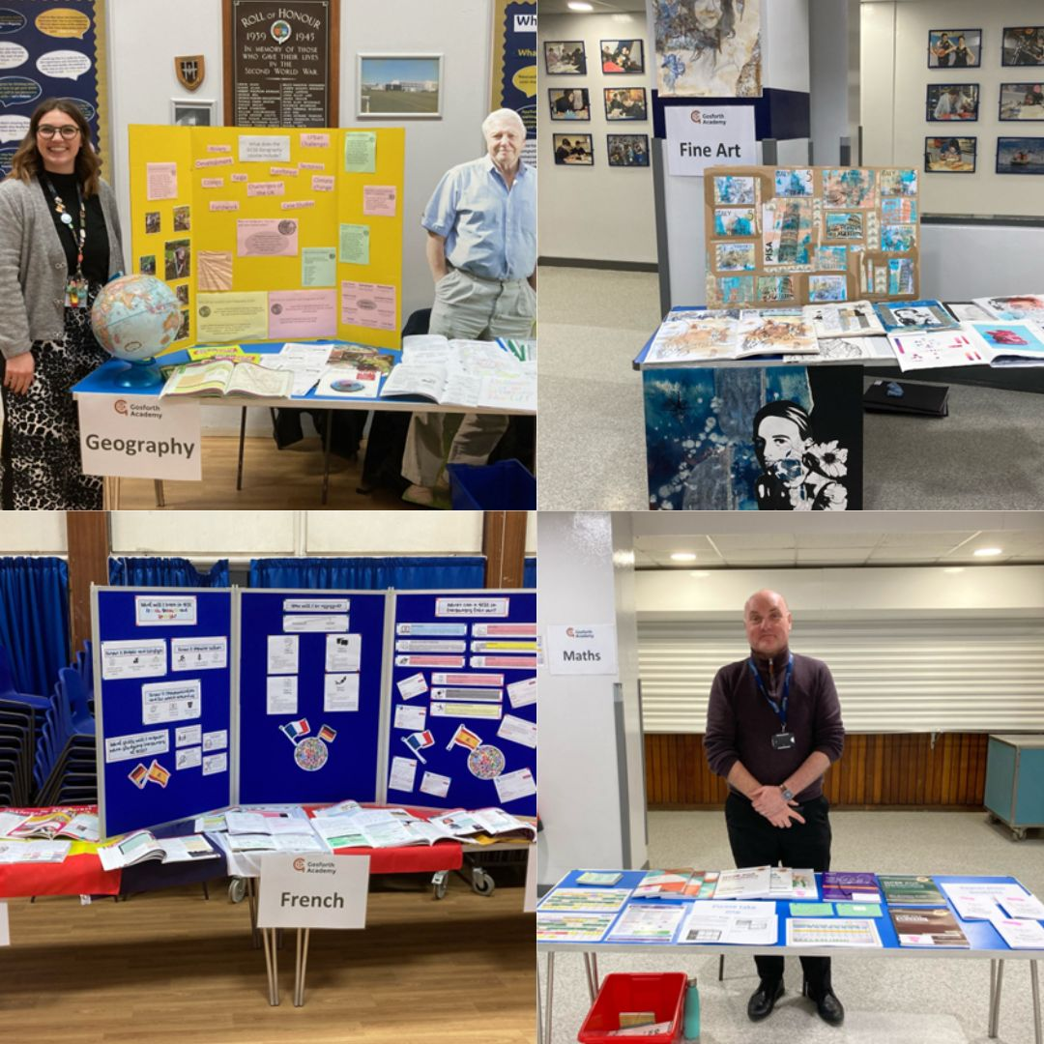
Useful Links: Geography, Art and Maths
Useful links to subject areas and potential career options in Geography, Art and Maths:
https://www.prospects.ac.uk/careers-advice/what-can-i-do-with-my-degree/geography
https://www.prospects.ac.uk/careers-advice/what-can-i-do-with-my-degree/fine-art
https://www.prospects.ac.uk/careers-advice/what-can-i-do-with-my-degree/mathematics
Create Your Future

Slide 5
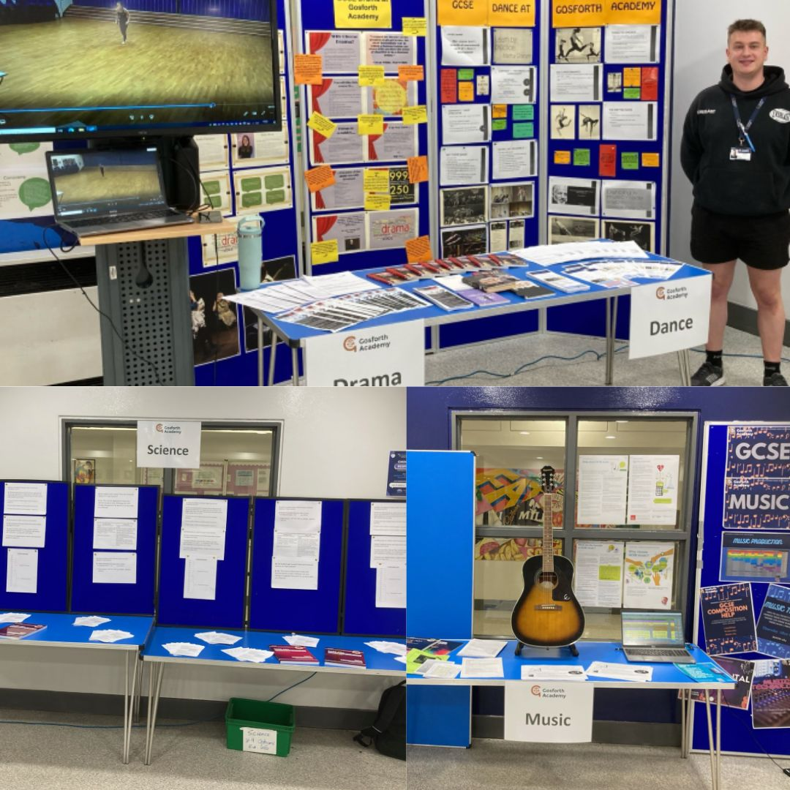
Useful Links: Drama, Music and Science
Useful links to subject areas and potential career options in Drama, Music and Science:
https://www.prospects.ac.uk/careers-advice/what-can-i-do-with-my-degree/drama
https://www.prospects.ac.uk/careers-advice/what-can-i-do-with-my-degree/music
https://www.prospects.ac.uk/job-profiles/browse-sector/science-and-pharmaceuticals
Create Your Future

Slide 6
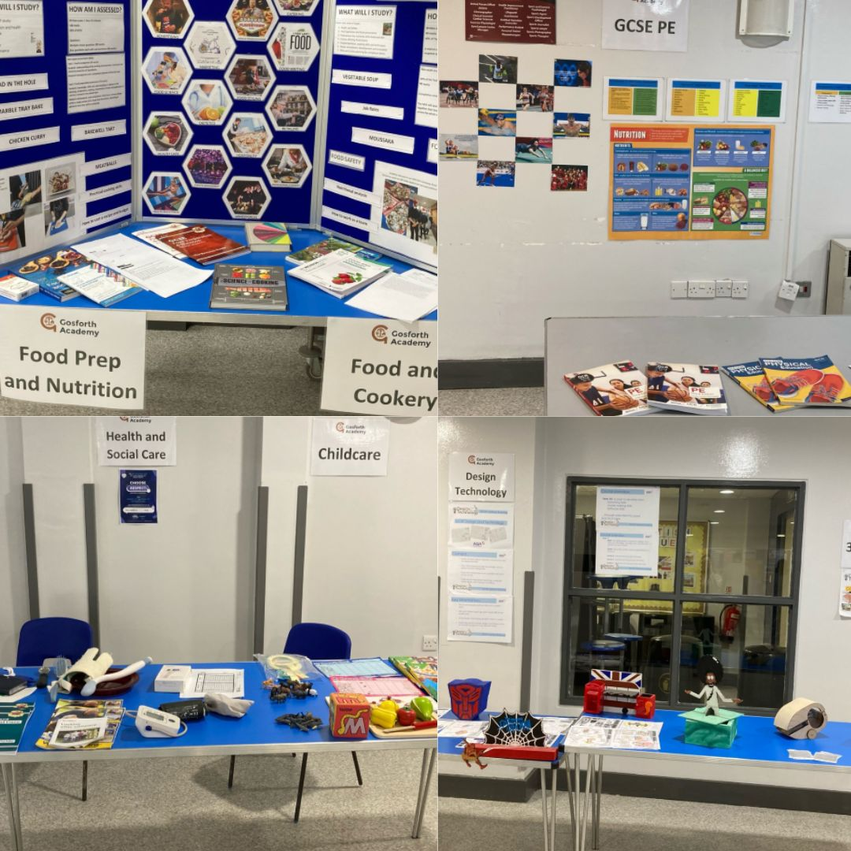
Useful Links: Health & Social Care, Childcare, Food Prep, PE and DT
Useful links to subject areas and potential career options in Health & Social Care, Childcare, Food Prep, PE and DT:
https://www.prospects.ac.uk/careers-advice/what-can-i-do-with-my-degree/health-and-social-care
https://www.prospects.ac.uk/jobs-and-work-experience/job-sectors/social-care/working-with-children
https://www.prospects.ac.uk/careers-advice/what-can-i-do-with-my-degree/food-science
https://www.prospects.ac.uk/careers-advice/what-can-i-do-with-my-degree/sport-and-exercise-science
https://www.prospects.ac.uk/careers-advice/what-can-i-do-with-my-degree/product-design
Create Your Future

Slide 7
Useful Links: MFL, History, and our Careers Education
Useful links to subject areas and potential career options in Modern Foreign Languages & History, and links to the Careers Education Programme for Years 9 to Year 11: :
https://www.prospects.ac.uk/careers-advice/what-can-i-do-with-my-degree/modern-languages
https://www.prospects.ac.uk/careers-advice/what-can-i-do-with-my-degree/history
https://www.gosforthacademy.org.uk/curriculum/careers
https://www.gosforthacademy.org.uk/_filecache/71b/8d2/12291-career-education-programme-years-9-11-24-25-2.pdf
Create Your Future

Slide 8
Create Your Future

