Slide 1

Open Evening 2026

Slide 2
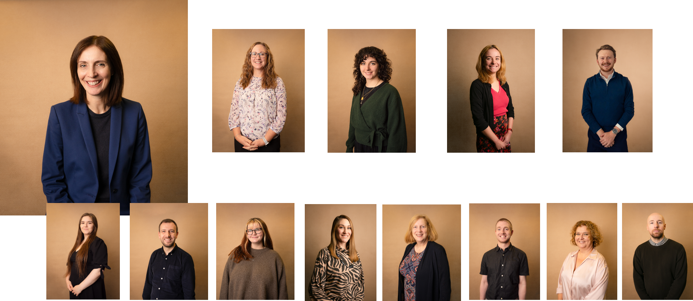
Sixth Form Team – Specialised Support
Creating Futures

Slide 3
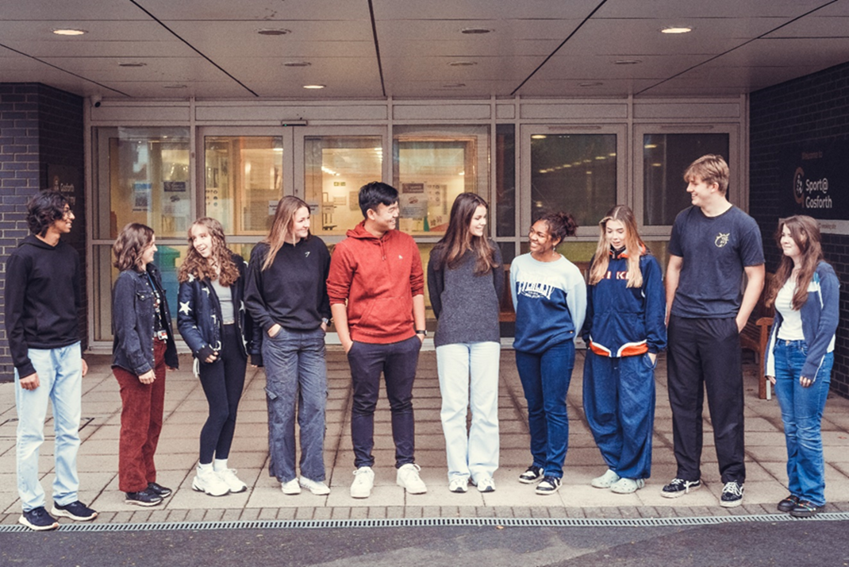
What is Gosforth Academy Sixth Form like?
Inclusive
Diverse
Welcoming
Supportive
Ambitious
Aspirational
Creating Futures

Slide 4
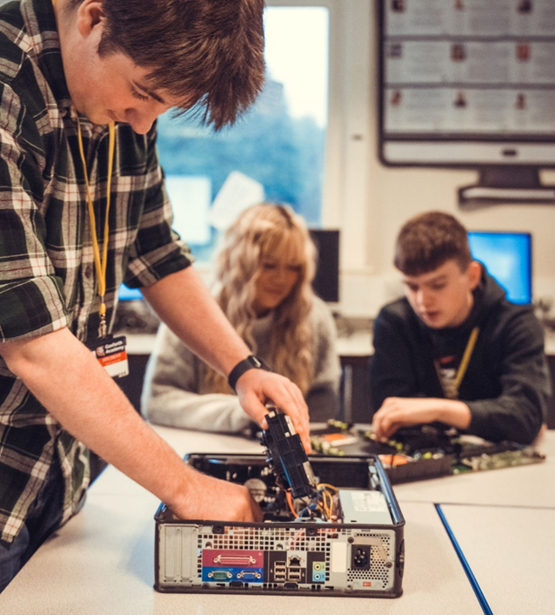
Comprehensive Choices
Wide range of A Level courses
6 Level 3 BTEC and CTEC and AAQ courses
Level 2/3 Access for A Levels course
Extended Project Qualification (EPQ)
Rugby Academy: ACE & DiSE
Resit GCSE English and Maths
Non-qualification courses: tutorials, assemblies, registration programme
Most students have a programme of three courses, plus non qualification commitments.
Most combinations are available: option blocks sent out in July
Course availability can change before September 2026
Creating Futures

Slide 5
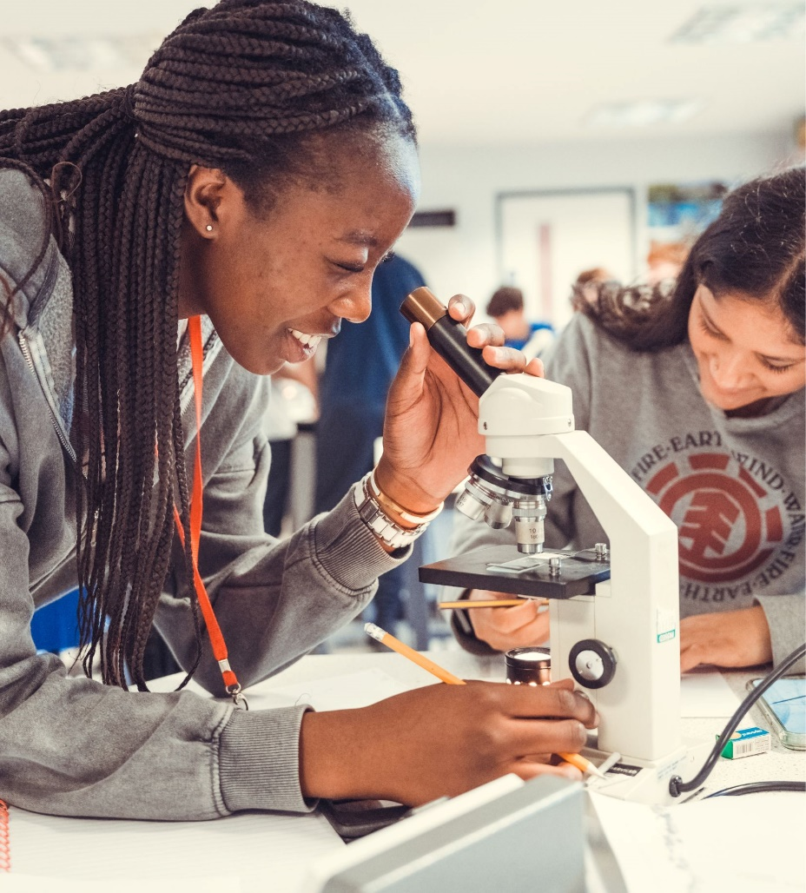
Entry requirements
Four grade 4s at GCSE or equivalent for Level 3 courses.
Four grade 3s at GCSE or equivalent for Access for A Levels.
Check entry requirements carefully for each course: GCSE grades, GCSE courses and APS (see prospectus).
It is possible to mix and match A levels and Vocational courses.
Creating Futures

Slide 6
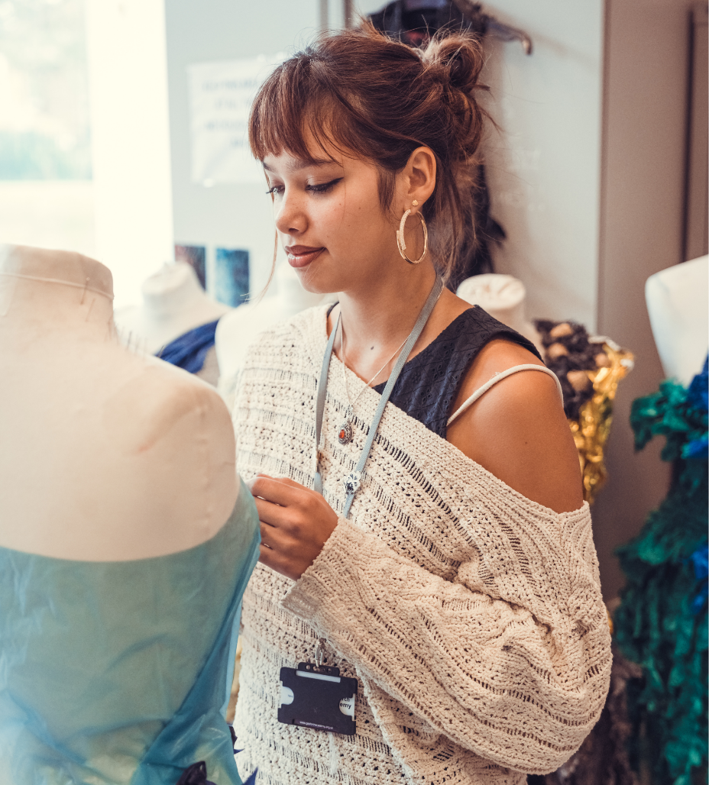
Advice to students
‘Thoroughly think about which subjects you’re taking.’
‘Choose subjects that you actually enjoy, not just what your parents think is best for you.’
‘Make sure you pick subjects you know you will do well in.’
‘Choose subjects based on what you want to do, not based on your friends.’
‘Think about your career when you pick A Levels.’
Creating Futures

Slide 7
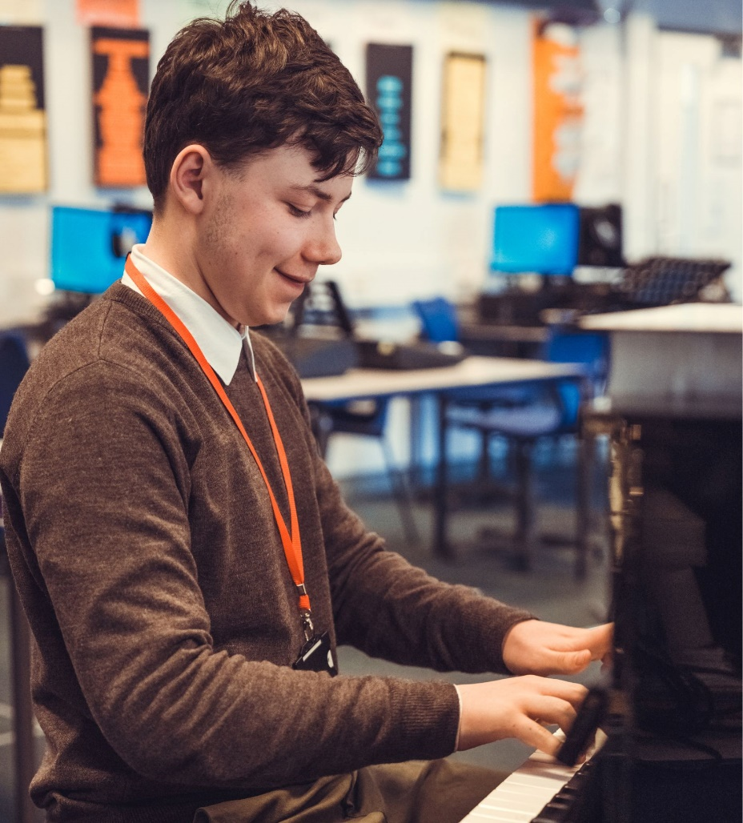
Exam Results and Destinations 2025
Overall Average Grade: B-
35% of grades A*-A
63% of grades A*-B
47% Distinction*-Distinction
82% Distinction*-Merit
251 students (75%) secured university /conservatoire places for 2025
Almost half of those progressing to university went to Russell Group universities
16 medicine & dentistry students
5 Oxbridge students
Creating Futures

Slide 8

Extracurricular Opportunities
Free use of the Sport@Gosforth gym during the school day (from P3 onwards).
Debate Society
Feminist Society
Music
MedSoc
Duke of Edinburgh: Silver
World Challenge
MFL Exchanges and Trips
Charity Activities
Student Union
Volunteering and leadership opportunities
Creating Futures

Slide 9
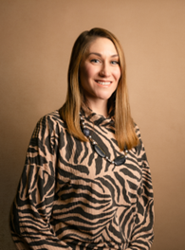
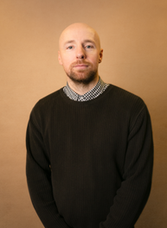
Careers and Progression
Careers Fair
Alumni & Career insight talks
A wide range of work and university related trips
Other supported provider events and programmes
Work Experience
One to one support and guidance from in-house careers advisers
Creating Futures

Slide 10
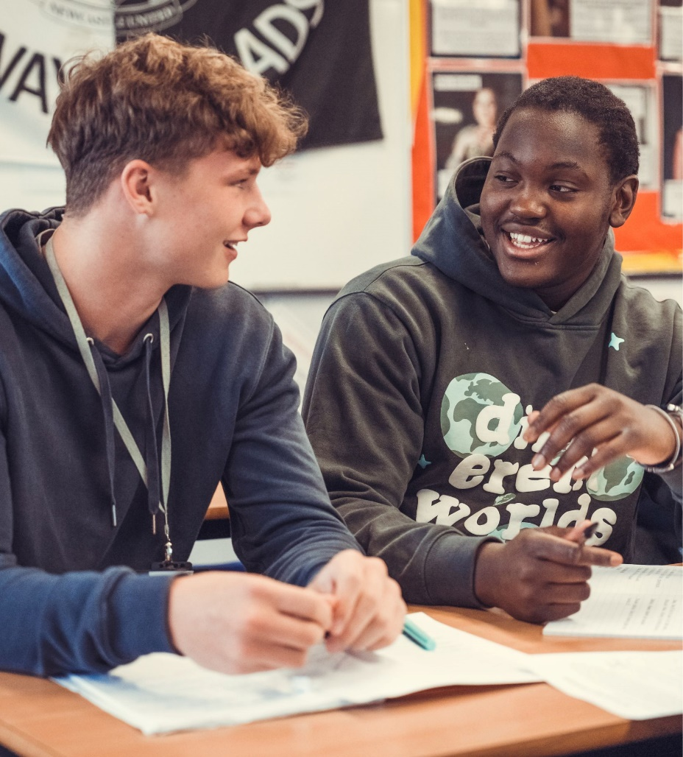
Transition: The Bridging Course 29 June-3 July 2026
Find out about the courses you may want to study.
Become familiar with:
  The environment/facilities.
  The teaching staff and methods.
  Some of the other students who may take similar courses.
  Additional opportunities that are available.
Understand the challenge that Sixth Form study provides.
Choose five courses to road test when you have your progression appointment.
Creating Futures

Slide 11

Key Dates 2025-26: Admissions Process
Sixth Form Open Evening: Thursday 8th January 2026 6-8pm
Applications must be made by 30th January 2026: complete form tonight, phone or email the school
Progression Appointments: 9th – 13st February 2026 at Gosforth
Offer Letters 9th March 2026
Bridging Course: 29thJune – 3rd July 2026
Enrolment: 20th August 2026 (GCSE Results Day!)
Creating Futures

Slide 12
‘Get enough sleep.’
‘Do well in your GCSEs.’
‘Be organised and work hard.’
‘Use free periods to study and do homework..’
‘Grateful how settled and secure my son feels. Really motivated to learn.’
‘It’s more relaxed than normal school but you still have to work hard.’
‘Have enough clothes.’
‘Make revision materials from the very start of Sixth Form to help you in the long run.’
‘Don’t get too stressed if you don’t understand things.’
‘My daughter’s 6th form tutor has been fantastic this term. Returned my call straight away when I had an issue and my daughter feels confident in talking to them, something she has struggled with in the past.’
‘Take advantage of opportunities and experiences.’
‘Extremely happy with the school. My son has thrived at GA.’
‘Have good attendance.’
‘It’s more different than you would think from main school:
more chill
more trust
closer student teacher relationship
smaller classes.’
‘Ask your teachers if you need help or have a question.’
‘Make use of one to ones to ask your tutor about any concerns about university and progression.’
‘Get involved in school, eg clubs, sports, reading mentoring.’
‘Try to make new friends.’
‘Try your best – that’s all that matters.’

Slide 13
Creating Futures

