Slide 1

Traditional values, longstanding success

Slide 2
Mr P Chahal
Principal
Creating Futures

Slide 3
Is my child going to be happy?
Gosforth Academy is a calm, orderly and purposeful environment where pupils feel safe​
Pupils treat one another with respect​
Staff build positive relations with pupils​
Leaders have developed a culture of high expectation​
Pupils work hard and achieve well​
Pupils talk positively about the opportunities open to them​
Routes into university are well-established​
Pupils benefit from high-quality careers provision​
Leaders are passionate about the school and the area they serve. They work hard to deliver positive outcomes for pupils
Creating Futures

Slide 4

Is my child going to be successful?
GCSE Headline Indicators 2025
Attainment 8 = 5.4 (Newcastle=4.3 and National = 4.6)
Progress 8 (2024) = 0.64 - in the top 5% of schools in the North East (SEND EHCP=+0.07 and SEND K= +0.44)
% of students achieving grade 5+ in English and Maths = 66% (Newcastle=42%, National= 46%)
% of students entered for the EBacc = 73%
% of students achieving the EBacc standard pass = 58% (England Average = 24%)
EBacc Average Points Score = 5.2
Creating Futures

Slide 5
Is my child going to be successful?
A-LEVEL Headline Indicators 2025
% grades at A*/A = 35%
% grades at A*-B = 63%
Average A level grade = B
Value Added Score A level = 0.15 (Sig +)
A levels average points score pr entry = 39.0
% Students achieving at least ABB in 2 or more facilitating subjects = 23.8%
Applied general average grade = Dist-
Applied General Vale Added Score = 0.35 (Sig+)
70 students had an average grade of an A or above (APS≥50 per entry)
Creating Futures

Slide 6
Mr P Snowdon
Deputy Principal
Curriculum
Creating Futures

Slide 7
Year 9 Curriculum at Gosforth Academy
Emphasis on the core subjects - English, Maths, Science, PE, PHSCE - continuing for all into KS4.
French and a second language (all first choices allocated).
January start for the Year 9 Options Process. Rollover in May.
Subject | Lessons | Subject | Lessons | Subject | Lessons
Maths | 8 | Geography | 4 | Design Technology | 2
Science | 8 | History | 4 | Food Technology | 2
English | 7 | Art | 3 | Drama | 2
Second MFL | 6 | PHSCE | 2 | Music | 2
French | 5 | IT and Computing | 2 | Guidance | 2
Physical Education | 4 | Religious Education | 2 | Enrichment | 1
Creating Futures

Slide 8
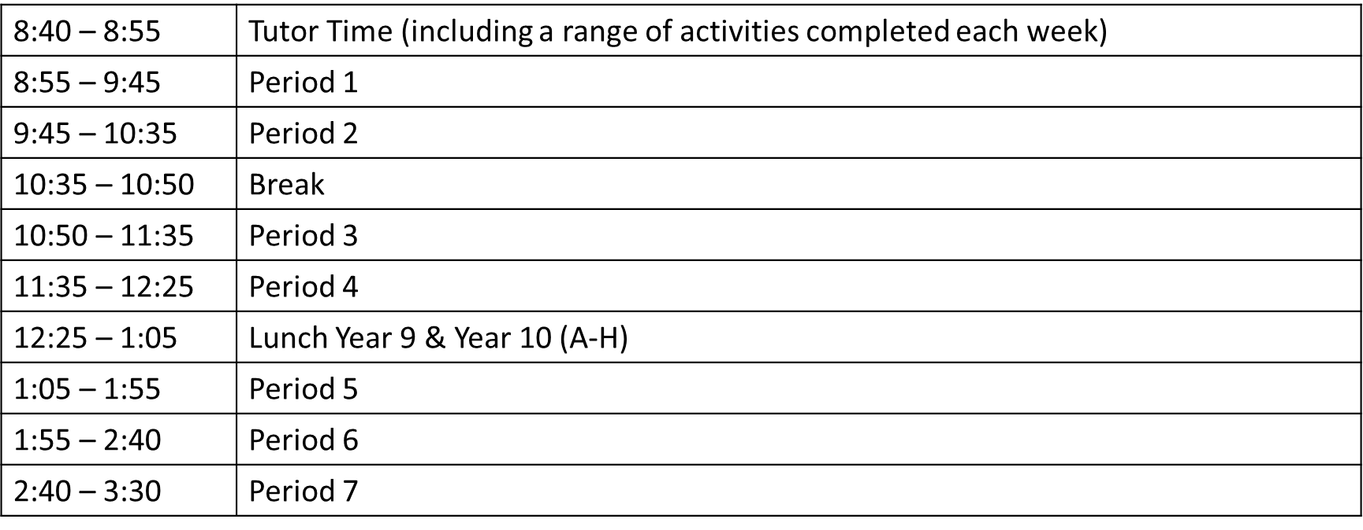
Timings of the day at Gosforth Academy for Year 9 Students
Tuesday & Friday – Gosforth Academy day finishes at 2:40pm.
Creating Futures

Slide 9

Enrichment Period
Added this year to encourage engagement in enrichment activities and will be added to student timetables as with any other lesson.
We asked all students for preferences on Intake Days and will try to match these with activities.
No changes will be possible, and students will be told which have been allocated at a later point.
Activities aim to :
  Develop practical skills, life skills, or personal qualities.
  Add further cross-curricular links.
  Allow students to try something new.
Creating Futures

Slide 10
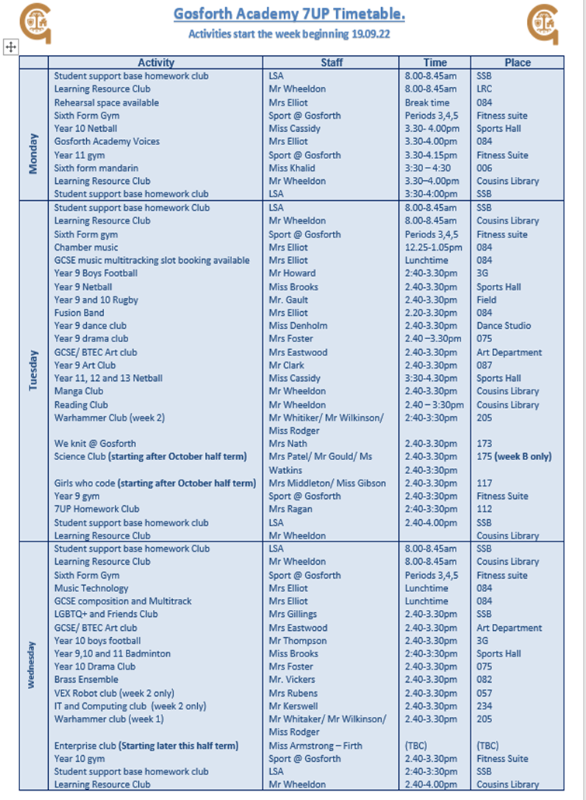
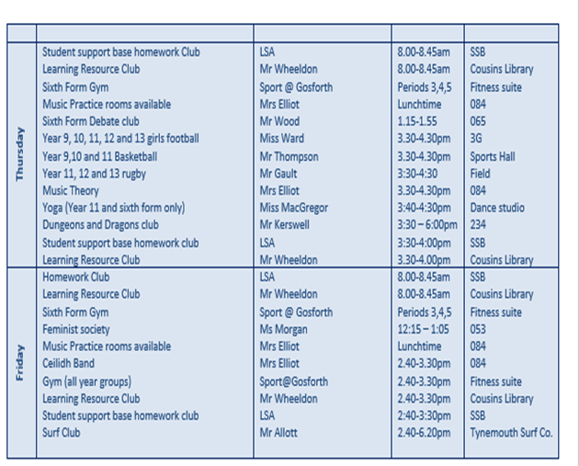
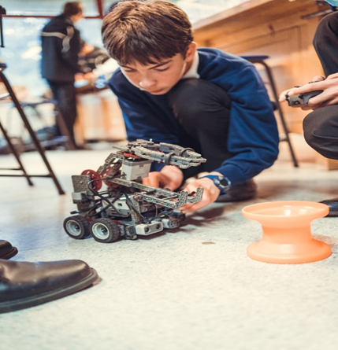
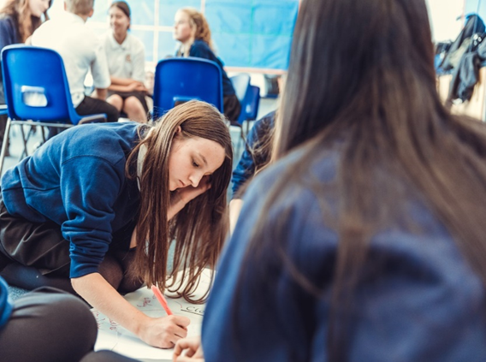
7UP timetable
This academic year we have had over 50 different enrichment activities available over the course of a week, with clubs running both at lunch times and after school.
There are wide range of different types of clubs available ranging from Sports Clubs to a Knitting Club, meeting the needs of all students.
We have a stamp system in place, which ties in with Gosforth Academy’s rewards system. This ensures that enrichment is an important part of the school day.

Slide 11
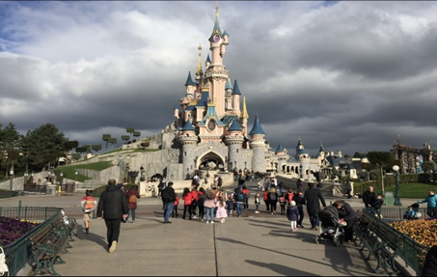
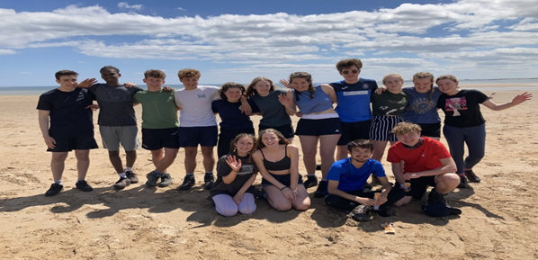
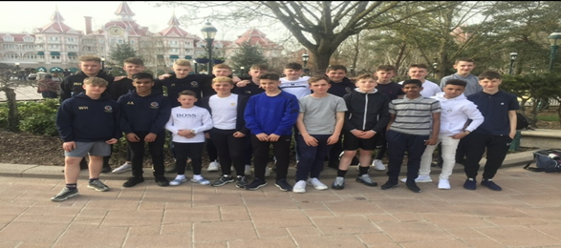
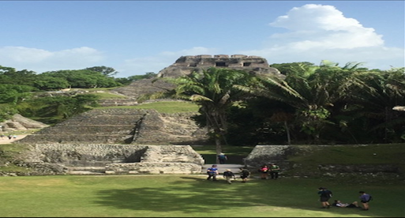
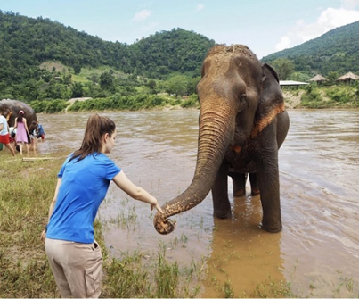
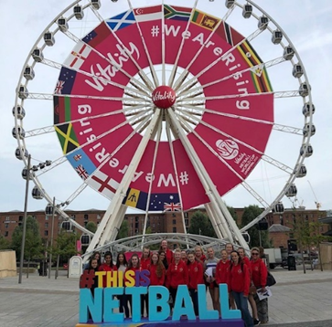
Activity Days/Residential Visits
Visits aim to build life skills, experiences, and perspectives, extending cultural capital.
World Challenge visits to destinations such as Cambodia (2026), Eswatini (2025) and Vietnam (2024).
An annual Geography visit to Iceland.
MFL Exchanges to Spain, France and Germany.
IT visit to Tokyo (2025).
Euro Disney and Paris (2026).
Poland (Auschwitz) for the 80th Anniversary commemorations.
Western/Eastern USA and New York.
History related activities in Italy.
Various DofE expeditions.
Creating Futures

Slide 12
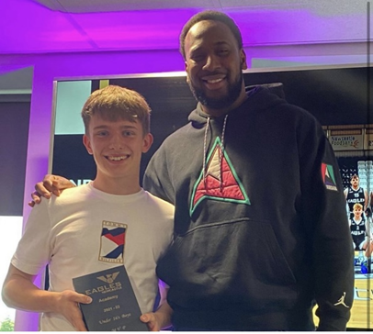
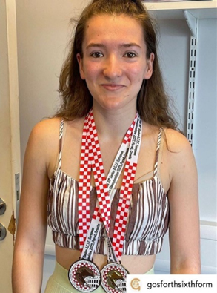
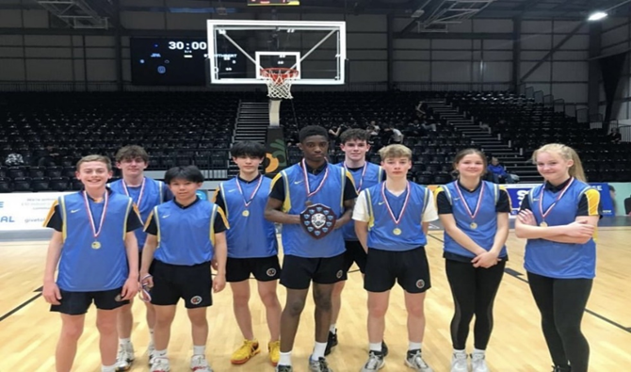
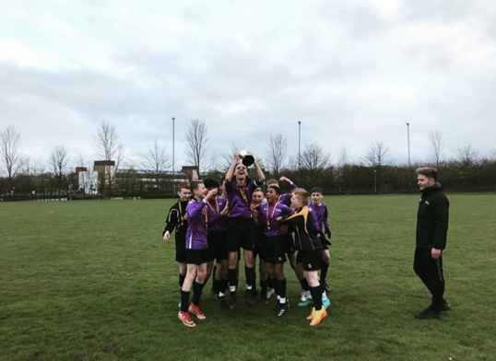
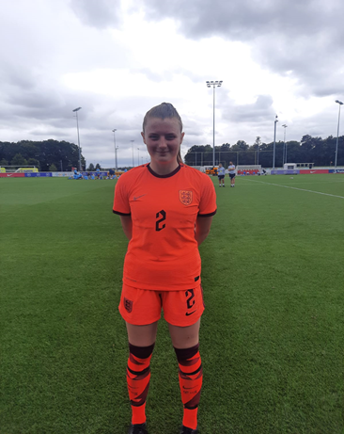
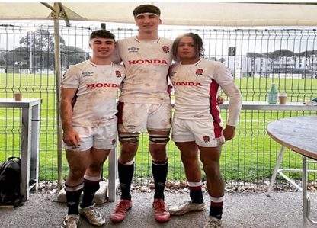
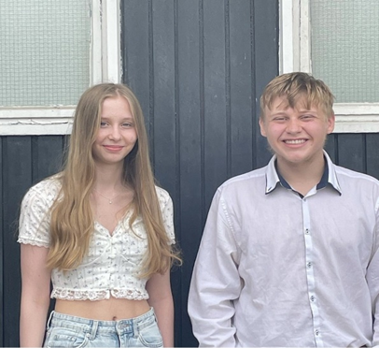

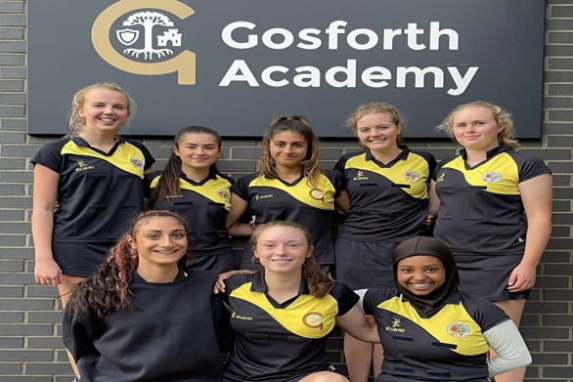
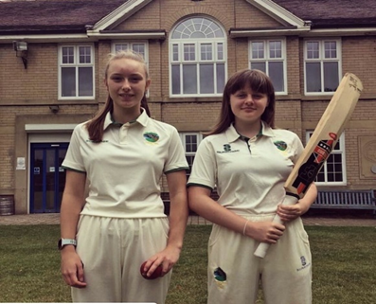
The Personal Development Programme has also been extended within departments.
Opportunities for students directly relating to their studies, supplementing/enhancing what has been covered, or simply used to enrich what they do.

Slide 13
Mrs R Marklew
Deputy Principal
Main School
Creating Futures

Slide 14
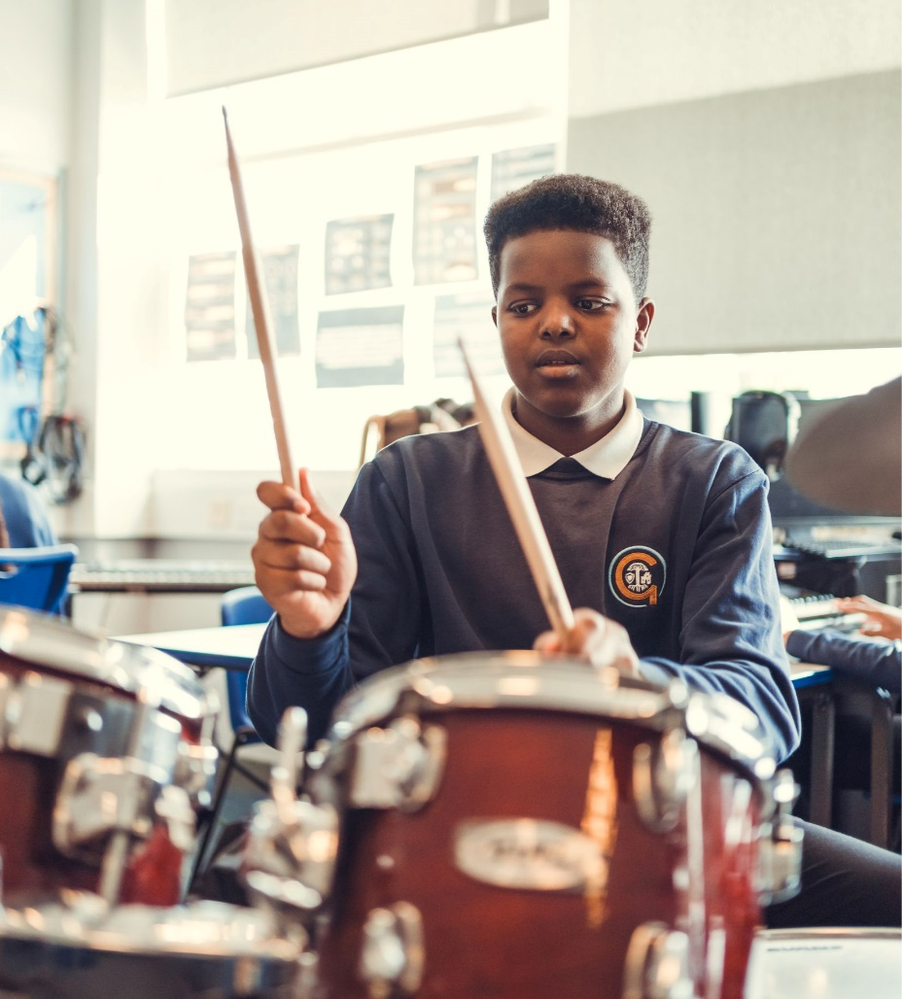
What do we ask of our students?
Excellent attendance, punctuality and uniform.
Good behaviour and a positive attitude to others.
A determination to learn and a willingness to face challenges.
A sense of personal responsibility.
Creating Futures

Slide 15
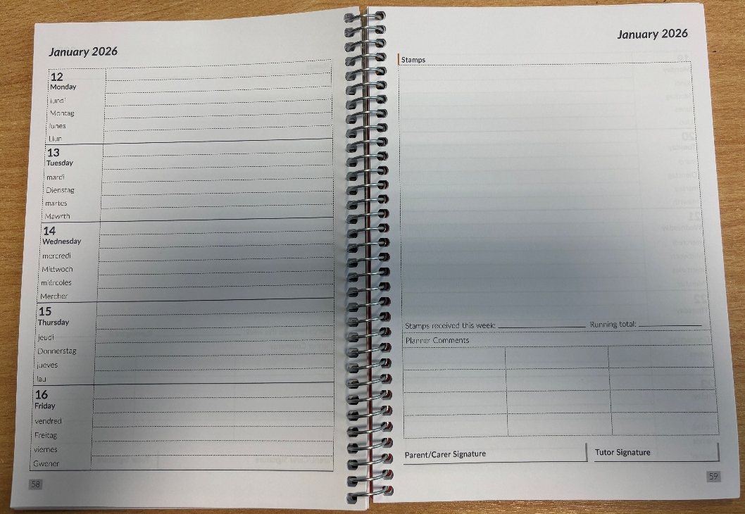
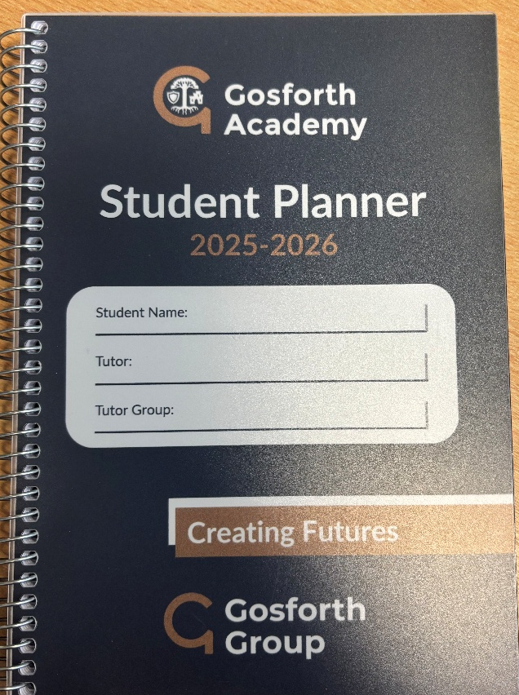
Planner
Planner is to be shown to duty staff as each student enters school each morning
Planner to be visible and on desks every lesson
Record homework, stamps and comments
Creating Futures

Slide 16

PRAISE
Rewards are the foundation of the Praise Code
All students receive rewards every lesson, every day
They involve an interaction between the student and the teacher in every lesson
Creating Futures

Slide 17
PRAISE CODE
In class a simple system operates
  Verbal warning
  Planner comment
  2nd Planner comment
  Moved seat
  Moved room
Further sanctions may follow.
Creating Futures

Slide 18
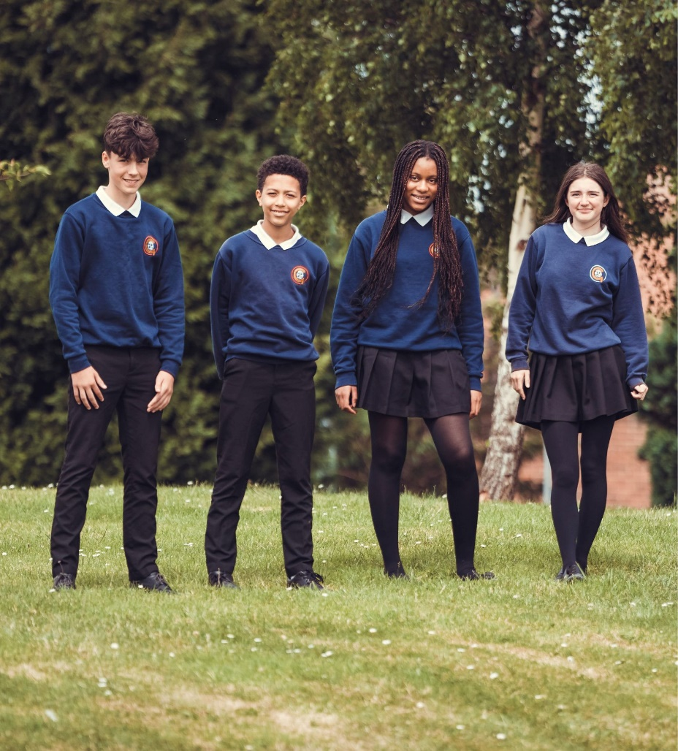

Uniform and Expectations
Our uniform supplier is;
Creating Futures

Slide 19

Uniform
A suitable warm and waterproof coat
Red circle
Black knee-length pleated skirt (which is pleated all the way round).
Plain black and smart, sensible school footwear (trainers or boots are not permitted)
PE kit – base layer
Creating Futures
Notes:
A suitable warm and waterproof coat which can be stored in the school bag during the day. Denim, leather, and camouflage-style coats are not permitted. which can be stored in the school bag during the day.

Slide 20
Uniform and Expectations
Jewellery is restricted to a watch. No smart watches
Hair accessories should be plain black, navy or white and not excessive
Excessive makeup, false eyelashes or extensions, false nails and nail varnish are not allowed in school.
No mobile phones, air pods etc are to be visible on school site. They need to be turned off and in school bag
Creating Futures

Slide 21
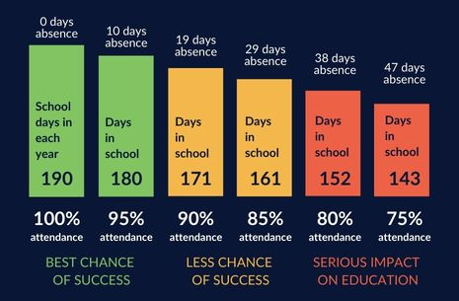
Why is good attendance important?
Vital for pupils to achieve their full educational potential​
Continuity of learning which makes progress and retention easier​
Continuity of relationships and friendships ​
​
Good references for further education or employment ​
​
Good habits are formed for later life ​
Creating Futures

Slide 22
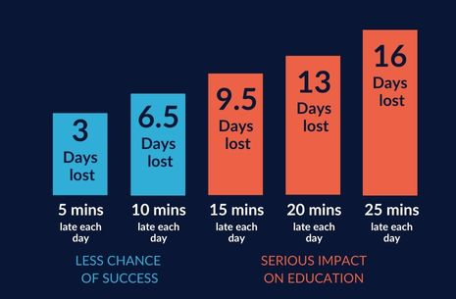
What can parents/guardians do to support their child?
Medical appointments - where possible book them outside of school hours.​
Family holidays - there are 175 days when students are not in school. ​
Illness - Do not allow your child to have time off for minor complaints or illnesses: if they are well enough to be up and about they are generally well enough to attend the school. ​
Punctual - ensure your child arrives to school on time and ready to learn
Creating Futures

Slide 23
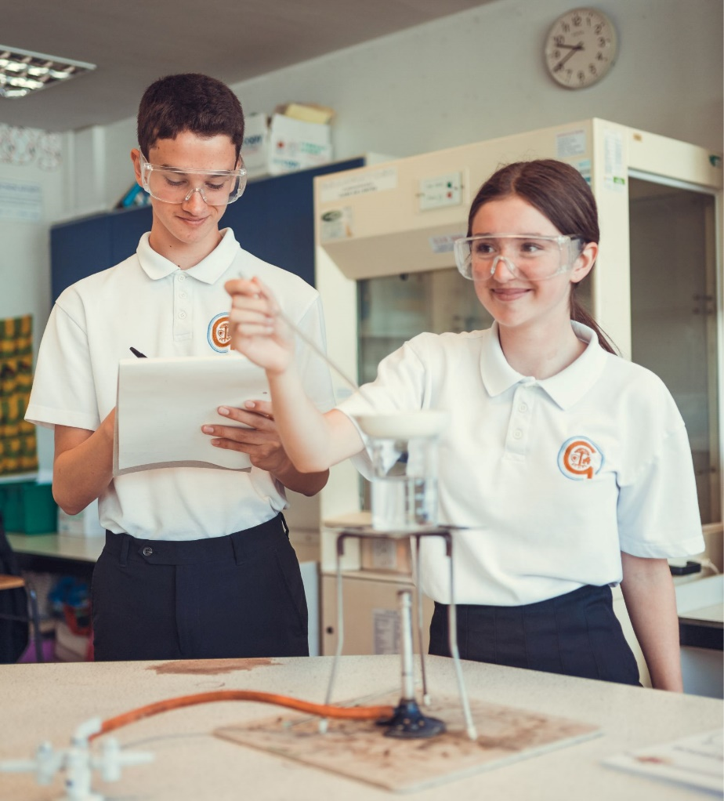
Pastoral Team
Form Tutor
Head of Year 9
Mr Duncan & Miss Lane
Pastoral Mentors
Mrs Rayner & Miss Bland
Creating Futures

Slide 24
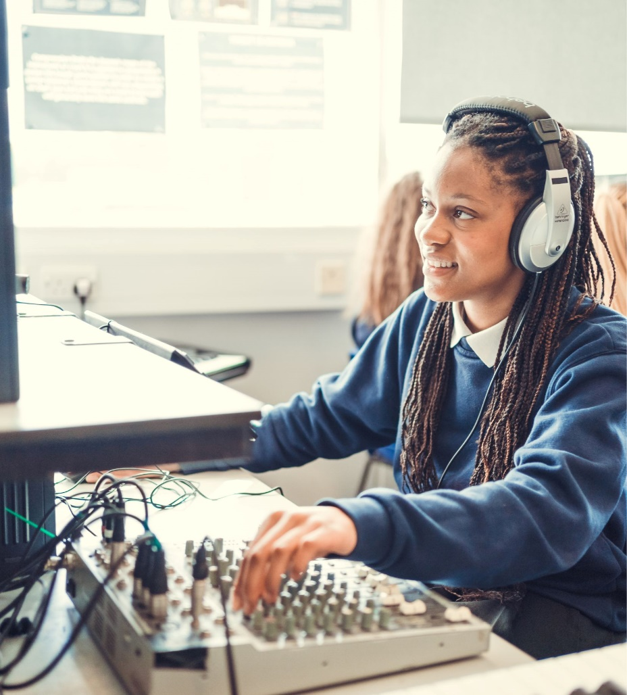
Transition Days
Wednesday 8 July & Thursday 9 July
Arrive by 8:35am
Tutor time
Lessons
2:40pm finish
Creating Futures

Slide 25

Start of Term
Wednesday
2 September 2026
Creating Futures

Slide 26
Mr G Mather
Deputy Principal
Inclusion & Student Experience
Creating Futures

Slide 27
Student Support
SENCO
Ms R Coady
Associate Leader SEND
Mr M Harrison
Creating Futures

Slide 28
Student Wellbeing
Mental Health Champion and Student Wellbeing Co-ordinator – Mr Mitchell
Key workers for students with Special Educational Needs
Designated person for Children in Care /previously in care
Young Carers
School Counsellors – Miss Wright and Mrs Wright
Trauma informed and relational approach to supporting students
Numeracy and Literacy programme
Excellent mechanisms to safeguard students
Multi-agency approach to supporting students and their families
PRAISE code
Creating Futures

Slide 29
Gosforth Academy Student Support Base (SEND)
Please e-mail to request further communication with the Student Support.
Thank you,
The Student Support Base
studentsupportbase@ga.newcastle.sch.uk
Create Your Future

Slide 30
Creating Futures

