Slide 1
GEOGRAPHY

Slide 2






Paper 1: Global Geographical Issues
Paper 2: UK Geographical Issues
Paper 3: People and Environment Issues
14th May 2025
Hazardous Earth
Development Dynamics
Challenges of an Urban World
6th June 2025
UK’s Physical Landscape
UK’s Human Landscape
Fieldwork – both human and physical
12th June 2025
People and the Biosphere
Forests under Threat
Consuming Energy Resources
All exams are 1 hour 30 minutes

Slide 3
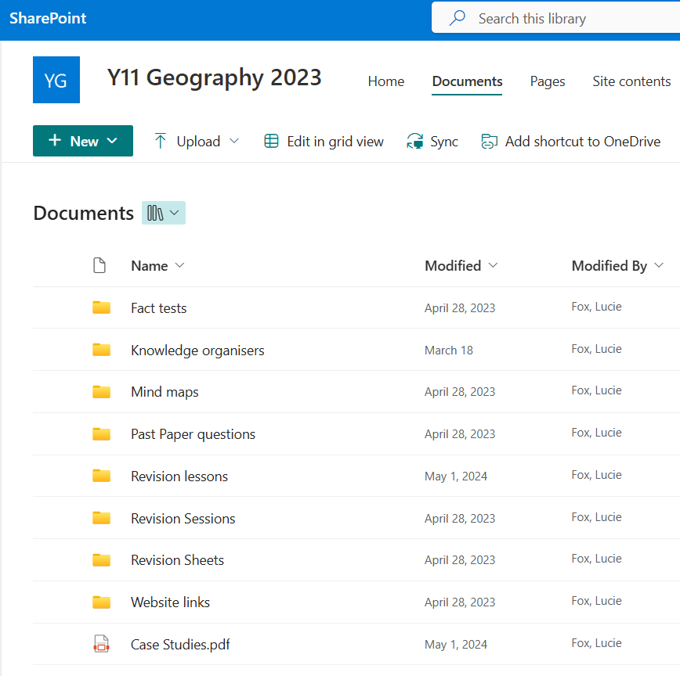





Geography Revision Tips
Use your exercise book and the CGP revision guide
Interact with the material in some way – make revision notes, flash cards, mind maps, practice questions etc.
Track your revision using the personalised learning checklist (PLC) on the Sharepoint
Use the Geography Sharepoint ‘Y11 Geography 2023’
Complete question practise and past papers (sharepoint and Edexcel B website)
Practise writing in timed conditions (1 minute per mark)
Practise 8 mark questions (balanced argument and judgement in conclusion, use the figure if there is one!)
Use online apps like Quizlet and Seneca
Revise case studies – create info cards, notes, posters, post-its with key facts on and learn!
Revise key terminology – use your glossaries (eg topography, intermediate technology, emerging)
Youtube channels - JCgeogsupport

Slide 4
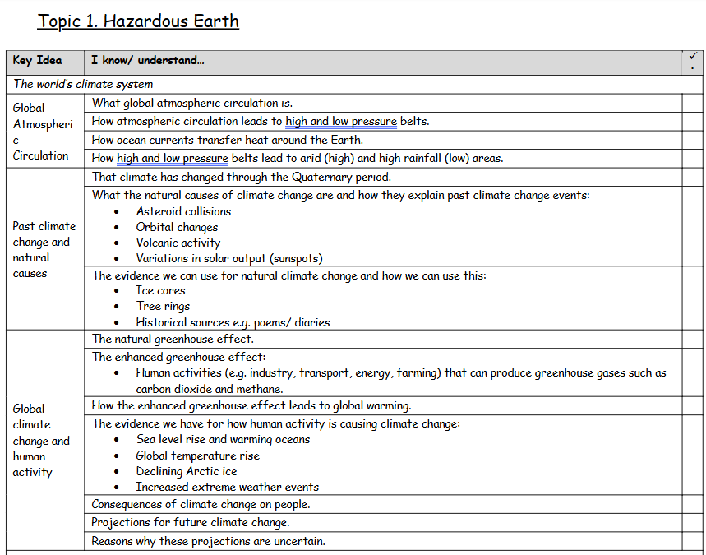
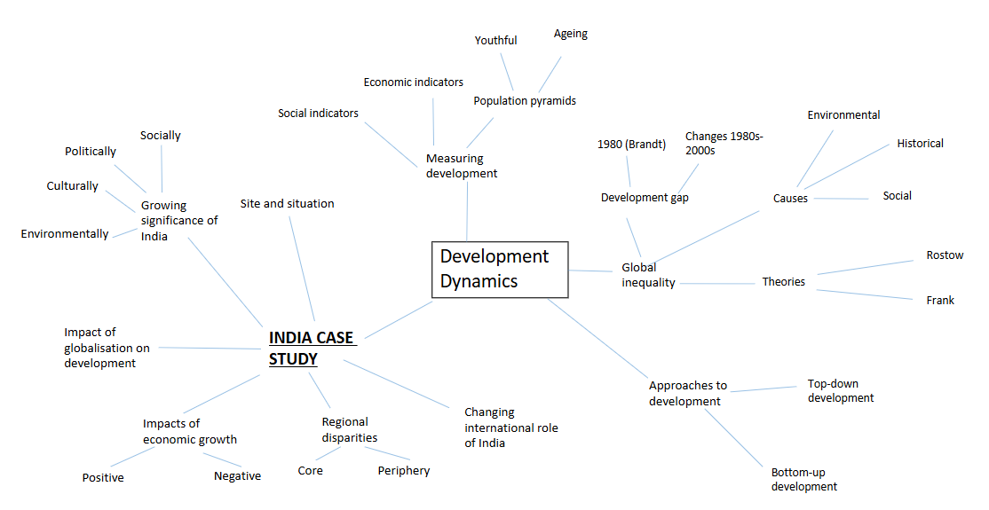
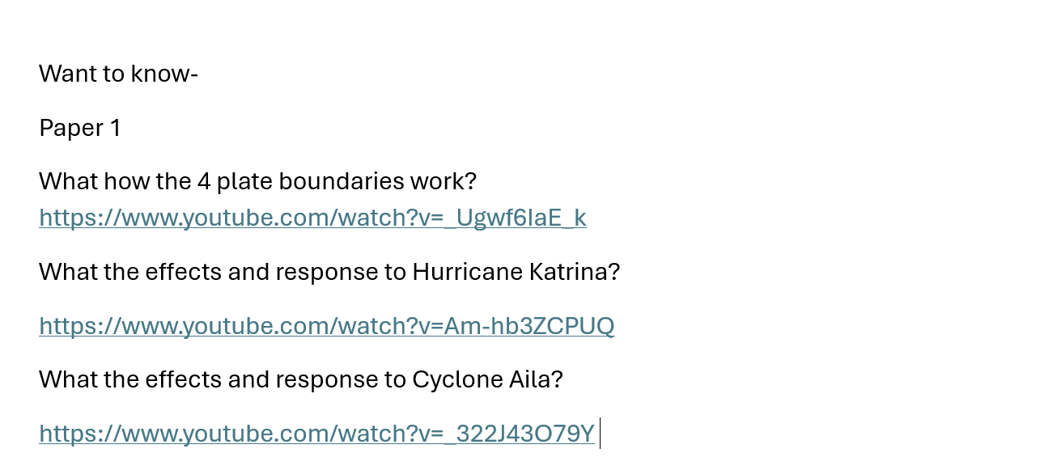
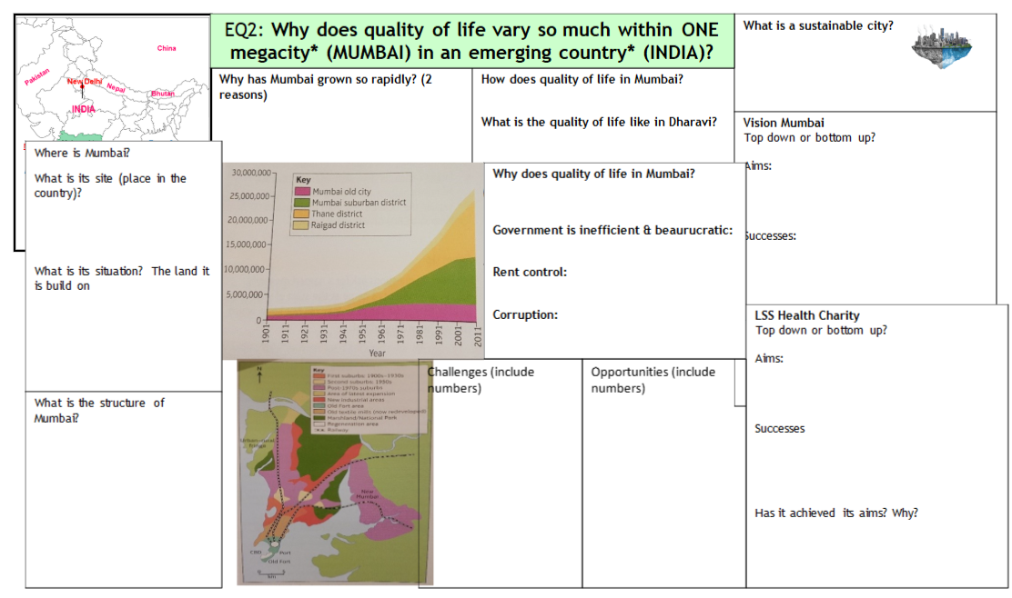
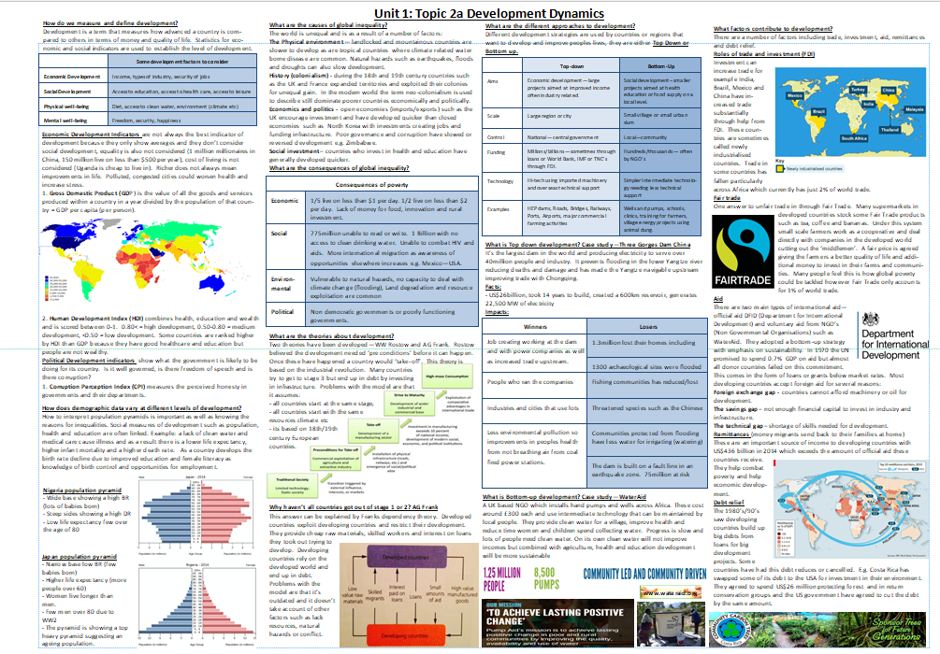

Slide 5
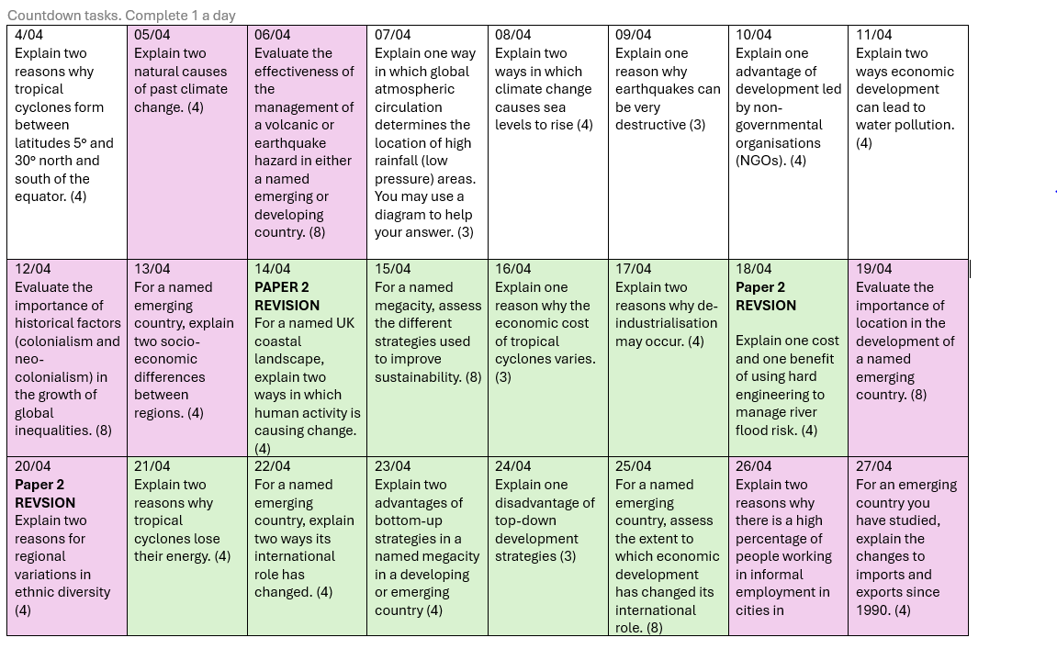
Countdown to exams
When revising it is important to chunk your revision.
I have created a 'question a day' leading up to your exams.
This will be found on the SharePoint site

Slide 6

Health and Wellbeing Support
Tutors and pastoral staff available
Mr Mitchell, Room 35
Tuesday after school

