Slide 1


GCSE English exam dates…
English Literature Paper 1 (‘Macbeth’/‘Romeo and Juliet’, ‘A Christmas Carol’/‘Frankenstein’): Monday 12th May 2025
English Literature Paper 2 (‘An Inspector Calls’, Power and Conflict Poetry, Unseen Poetry): Tuesday 20th May 2025
English Language Paper 1 (fiction): Friday 23rd May 2025
English Language Paper 2 (non-fiction): Friday 6th June 2025

Slide 2
How to organise your revision…
RAG-rate your knowledge of each set text in English Literature (‘Macbeth’ or ‘Romeo and Juliet’; ‘A Christmas Carol’ or ‘Frankenstein’; ‘An Inspector Calls’; Power and Conflict Poetry) – for each chapter/scene/Act level, and for the text as a whole. For example, ‘An Inspector Calls’ – Act 1; Act 2; Act 3. Focus your revision time on turning the reds and ambers into greens.
Create your own Personalised Learning Checklists for each character, theme, chapter/scene/Act in each text and RAG-rate your knowledge of these. Again, prioritise turning the reds and ambers into greens, instead of focusing on things you already know really well.
Identify the key themes for each English Literature text (e.g. fate, kingship, supernatural, ambition, loyalty (and lack of!), guilt in ‘Macbeth’) – and then write key chapters/scenes/moments in which we see these themes, as well as characters and quotes the themes relate to. RAG-rate your knowledge for each theme, and again, prioritise revising the reds and ambers.
Revise all set texts – but spend more time on the texts you know least well. Your mock exam results for the two English Literature papers should guide you with this.

Slide 3
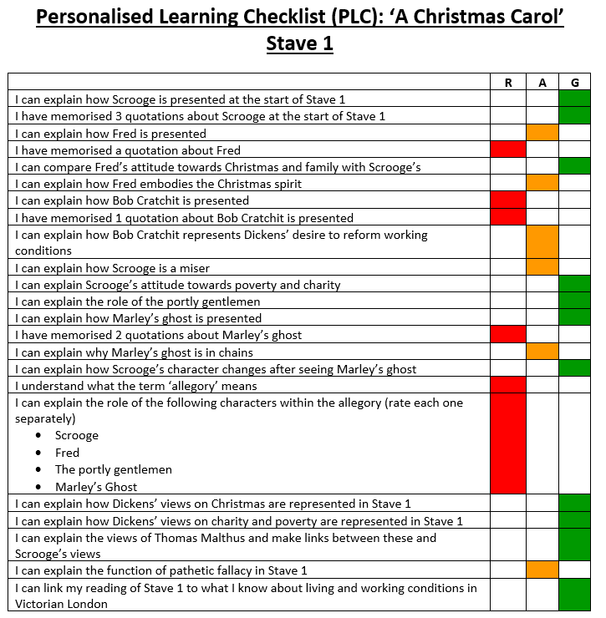
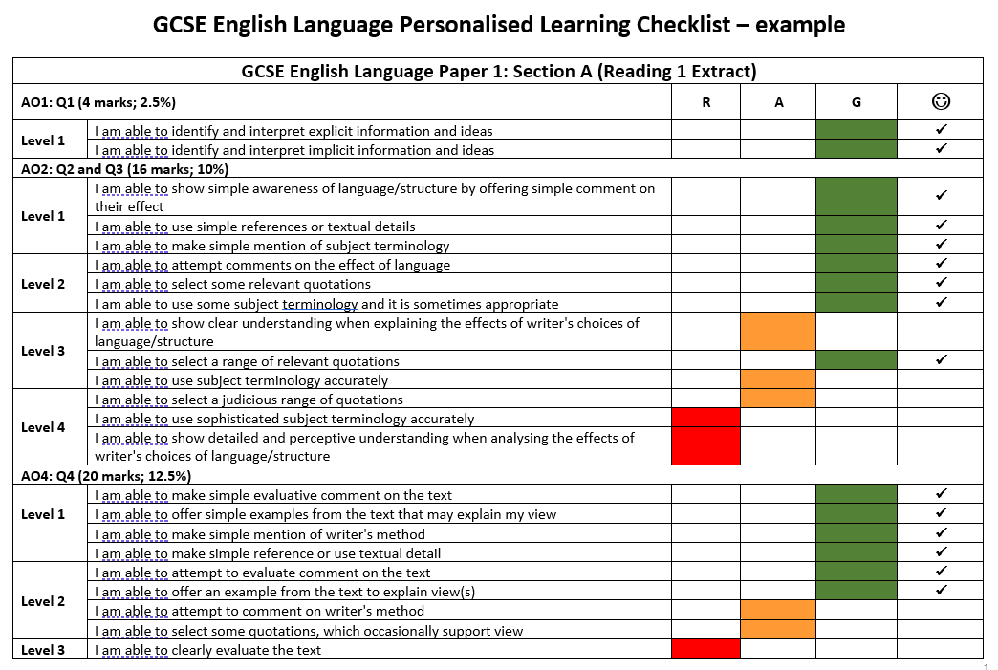
RAG-rating examples…

Slide 4
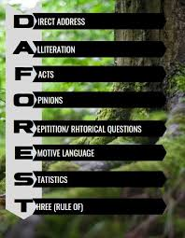




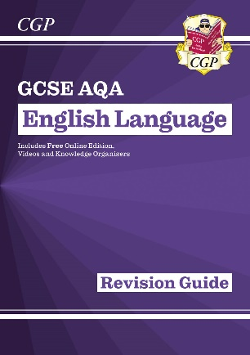



English Language Revision Tips…
Use your CGP guides!
Complete past papers
Use the revision materials and notes on the BBC GCSE Bitesize website
Make revision cards for methods. Try the Anki app!
Create mind maps or knowledge organisers for each paper (fiction and non-fiction)
Revise key terminology for both papers (e.g. DAFOREST; pathetic fallacy; symbolism; allegory; allusion; anaphora; rhetorical question)
Re-read your exercise books/class notes regularly
Practise writing essays and developing your ability to structure your responses
Practise writing descriptive and narrative pieces and developing your ability to structure your responses
Read a range of fiction texts from the twentieth century and analyse the methods used (language and structure) to prepare for Paper 1.
Read a range of non-fiction texts from the 19th, 20th and 21st centuries and analyse the language methods used language to prepare for Paper 2. Newspaper websites like The Guardian are useful for this!
Practise writing in timed conditions – and time yourself!
Seneca Learning website
‘Mr Bruff’, ‘Mr Everything English’, ‘Mr Salles Teaches English’ YouTube channels

Slide 5

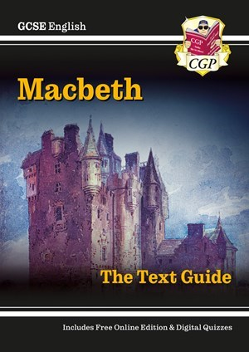
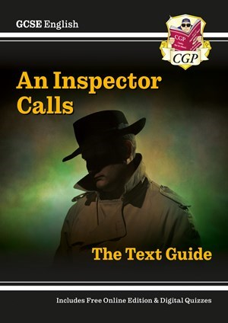
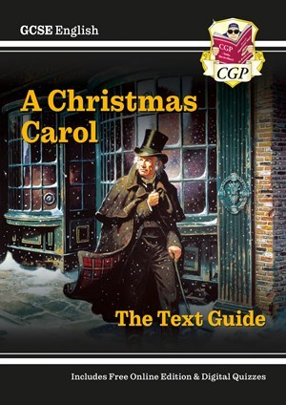


English Literature Revision Tips…
Use your CGP guides! You have them for all units...
Use the revision materials and notes on the BBC GCSE Bitesize website
Complete quizzes on www.sparknotes.com and BBC GCSE Bitesize websites
Reread the GCSE English Literature texts in your revision time so that you can remember what happens in the texts, and when (texts are available to download online)
Make revision cards for the plot, key moments, characters, themes, big ideas, methods and key quotations in each of the texts (‘Frankenstein’, 'A Christmas Carol', ‘An Inspector Calls’, ‘Macbeth’, Power and Conflict poetry). Try the Anki app!
Create mind maps or knowledge organisers for each text/character/theme/big idea
Complete past papers
Revise key terminology for all topics
Re-read your exercise books/class notes regularly
Create summaries and revision diagrams for each of the texts
Listen to audio book versions of the texts (can be found on YouTube)
Write quotes on post-it notes and stick them all over your bedroom/house!
Watch film versions of the texts on BBC iPlayer/Netflix to revise the plot, characters and themes.
Seneca Learning website
‘Mr Bruff’, ‘Mr Everything English’, ‘Mr Salles Teaches English’ YouTube channels

Slide 6
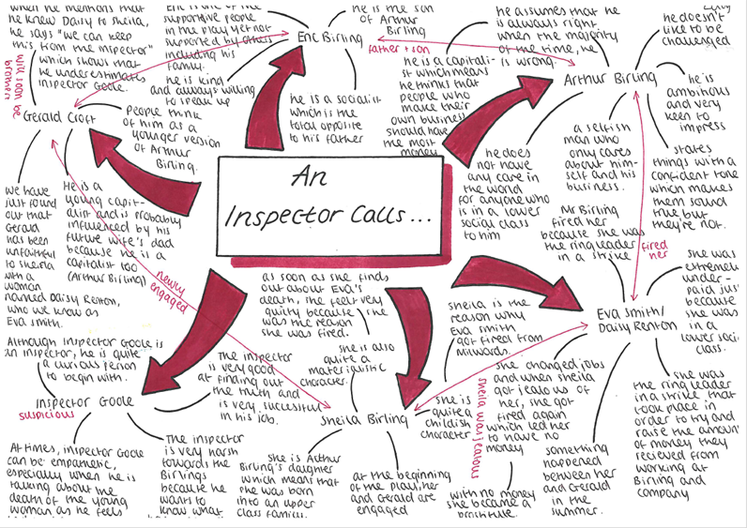
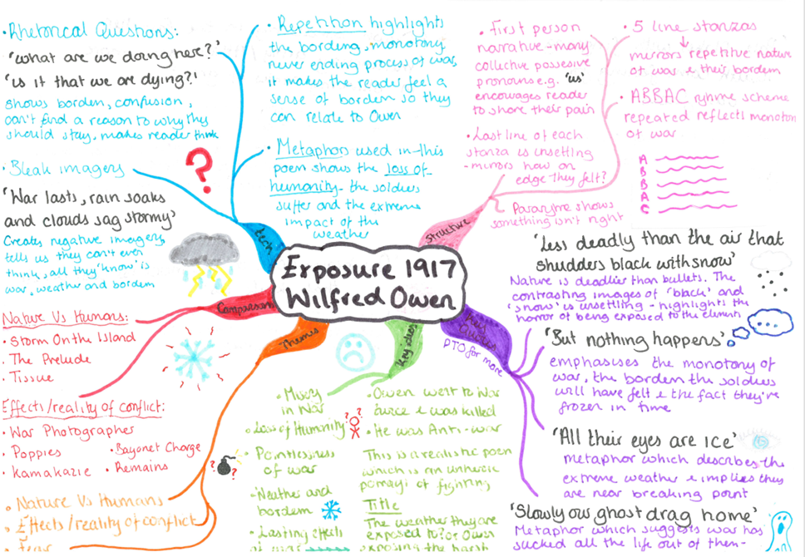
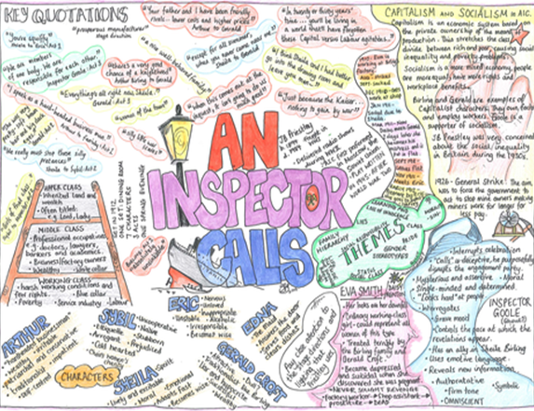
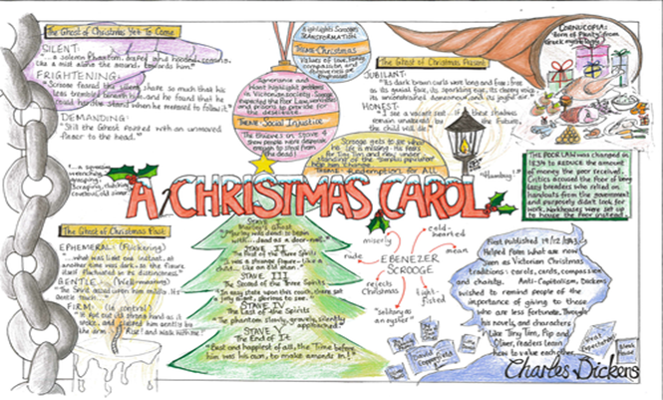
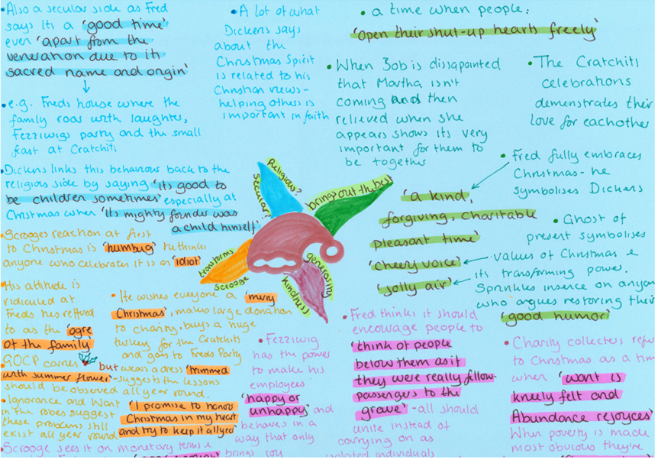
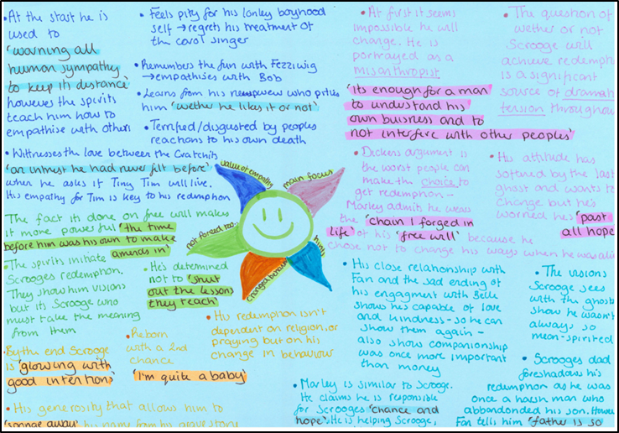
Examples of other students’ revision mindmaps…

Slide 7
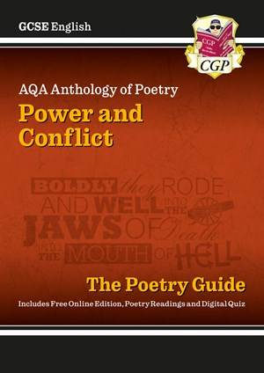
Where to find exam questions or full papers…
AQA website (see https://www.aqa.org.uk/subjects/english/gcse/english-8700/specification for English Language and https://www.aqa.org.uk/subjects/english/gcse/english-8702/specification for English Literature)
Via the “S:” (“Student”) drive on Frog. All past papers are available to you here!
Seneca Learning website/app
CGP guides have exam questions (and some model answers!) in the back. Students have these for all units.

Slide 8
Checking and assessing understanding…
Use the mark schemes on the AQA website and the “S:” (“Student”) drive on Frog. All past papers and mark schemes are available to you here! Check that you have written three analytical sentences for each quotation, and that you have written about writers’ methods, intentions and message, and the effects of language on reader/audience. To access the higher marks, check that you have written about structure and discussed alternative interpretations.
Compare your own answers with the graded model answers that you have access to in your exercise books, in the CGP revision guides and on Frog.
Complete knowledge quizzes on the BBC Bitesize and Seneca Learning websites. Make a list of the topics, themes and contextual points that you do not score highly on – and then revise these. Take the quizzes again and see if you have improved!
Ask your teacher to look at some of your answers and give you some feedback.

Slide 9


