Slide 2
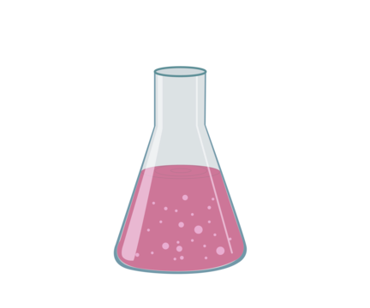
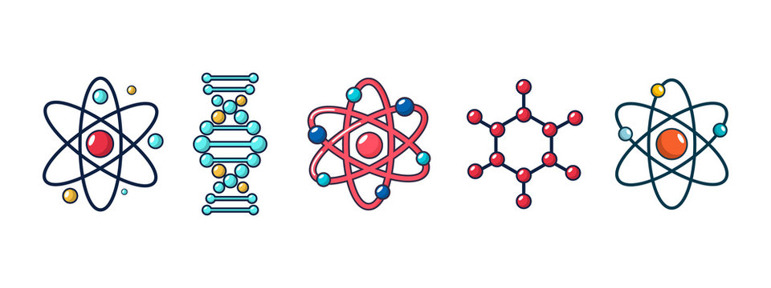


Biology
Chemistry
Physics
13th May 2025
B1 - Cell Biology
B2 - Organisation
B3 - Infection and Response
B4 - Bioenergetics
19th May 2025
C1 - Atomic Structure
C2 - Bonding structure and properties of matter
C3 - Quantitative Chemistry
C4 - Chemical Changes
C5 - Energy Changes
22nd May 2025
P1 - Energy
P2 - Electricity
P3 - The particle model
P4 - Atomic Structure
Paper 1
9th June 2025
B5 - Homeostasis
B6 - Inheritance, variation and evolution
B7 - Ecology
13th June 2025
C6 - Rate and extent of chemical change
C7 - Organic Chemistry
C8 - Chemical Analysis
C9 - The Atmosphere
C10 - Using Resources
16th June 2025
P5 - Forces
P6 - Waves
P7 - Electromagnetism
P8 - Space *triple only*
Paper 2

Slide 3
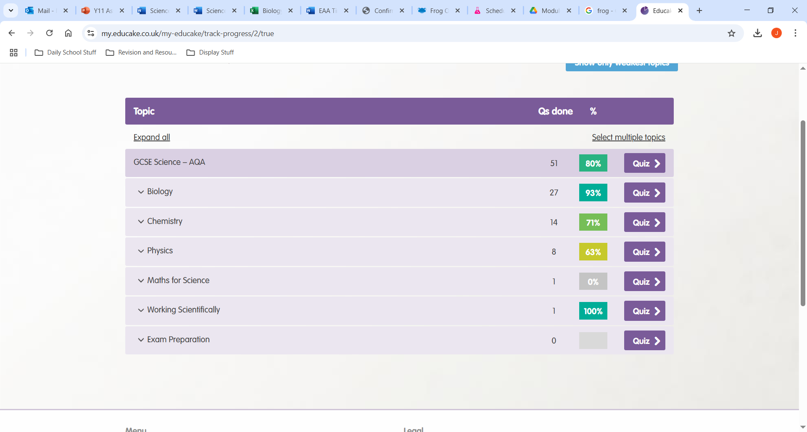
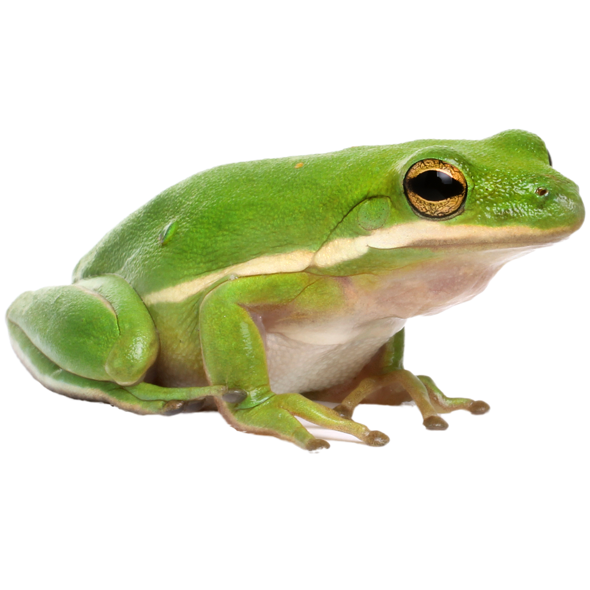
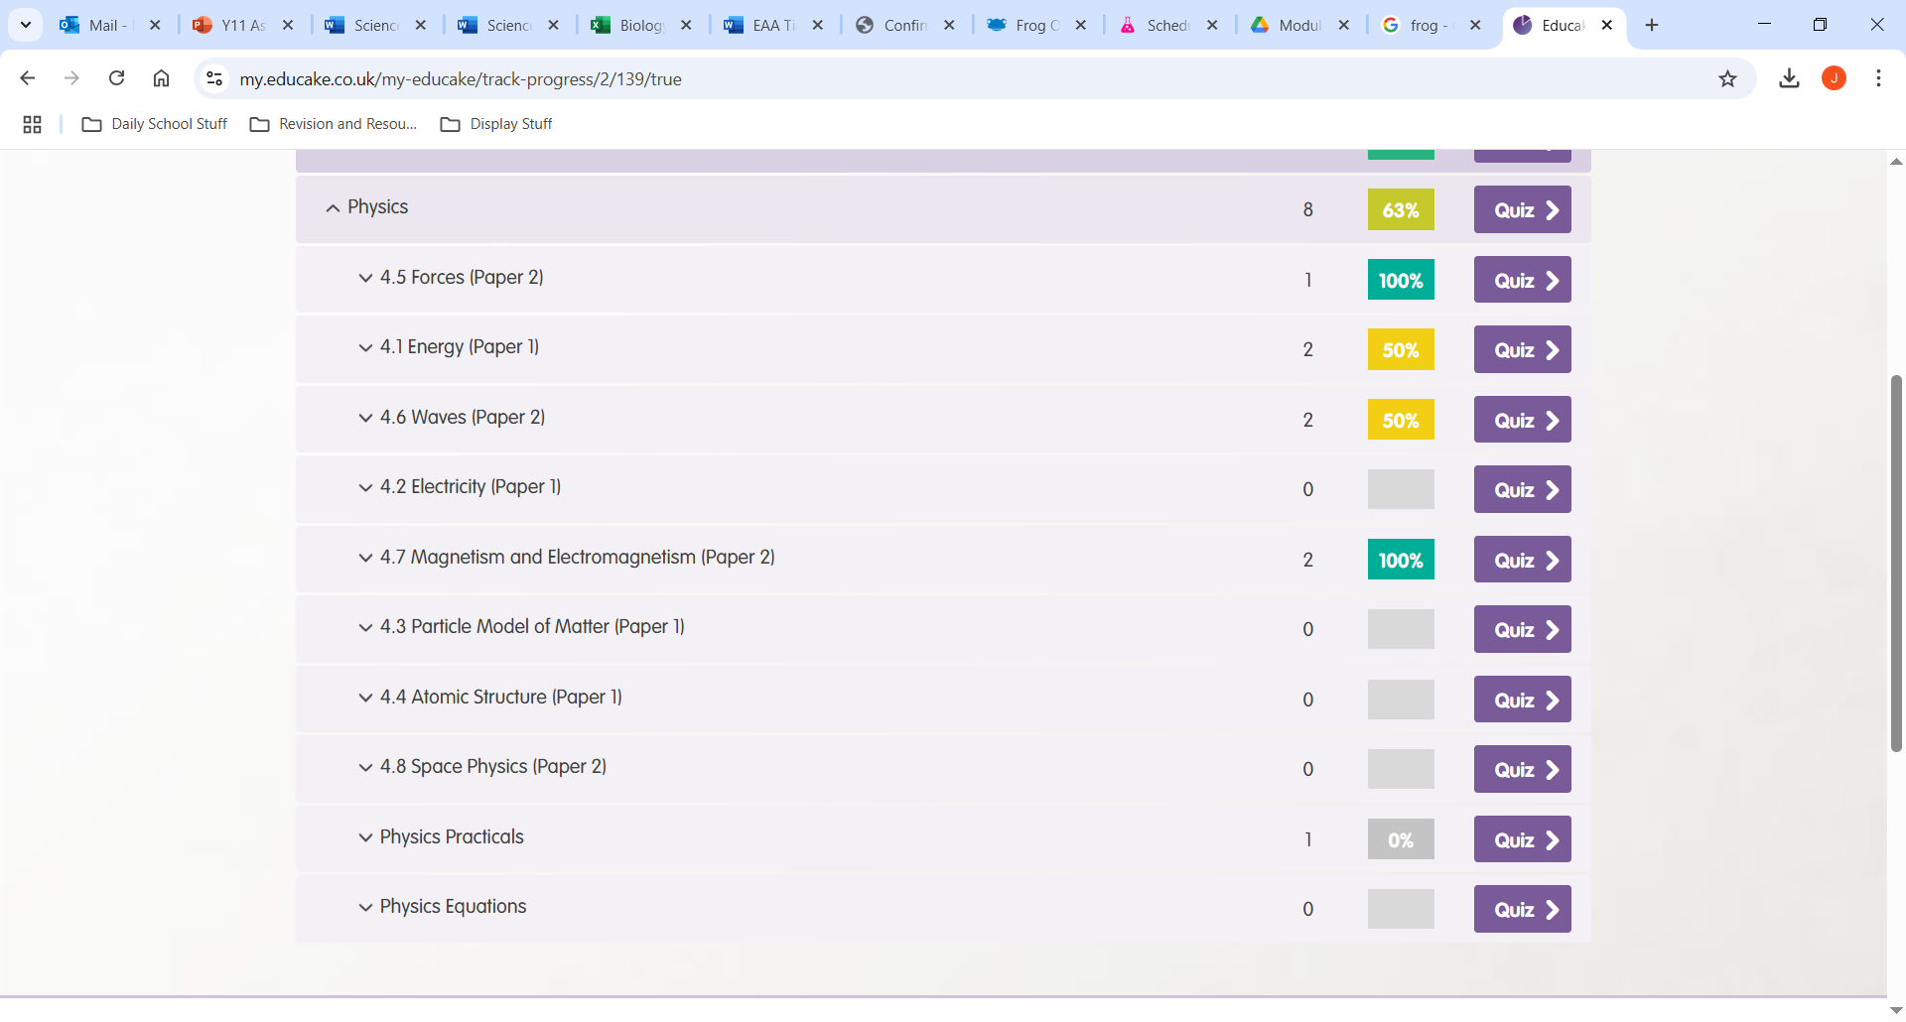
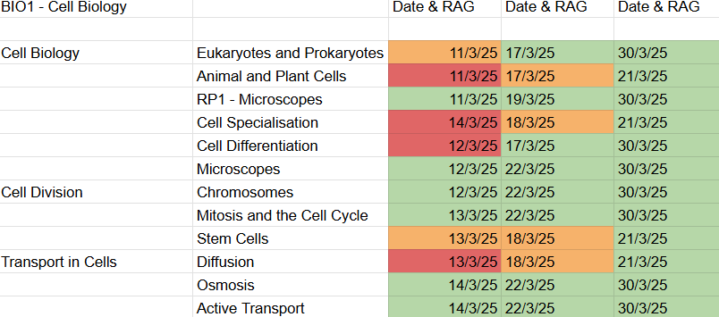
Feeling bemused by Biology? Confused by Chemistry? Perplexed by Physics? Science can be very overwhelming to approach for revision so here are some top tips to help get you started!
Use the specification along with a RAG sheet
Using a Red/Amber/Green sheet can be a fantastic starting point for you to identify areas you need to focus on. You can also use your Educake account to help with this.
Trilogy specification
Triple Biology
Triple Chemistry
Triple Physics

Slide 4
Preparation - organise your revision materials, clear your space, remove distractions, make sure you know what is in each topic/exam and pick one to start with.
Pick a topic
*use Educake/RAG sheet*
Educake
Online resources for AQA GCSE Science:
Cognito
PhysicsandMathsTutor
Freesciencelessons
BBC Bitesize
Step 1 - Review everything in the topic
Your exercise books
Revision guides
Educake
Flashcards
Make a note
Be specific
Re-test.
Step 2 - Test yourself
Look, cover, recall
Seneca
AQA Website
Step 3 - Exam practice
Physics and maths tutor
Educake
Cognito

