Slide 1



PARTNERS Programme
Supported Entry Route
FROM NEWCASTLE. FOR THE WORLD.

Slide 2
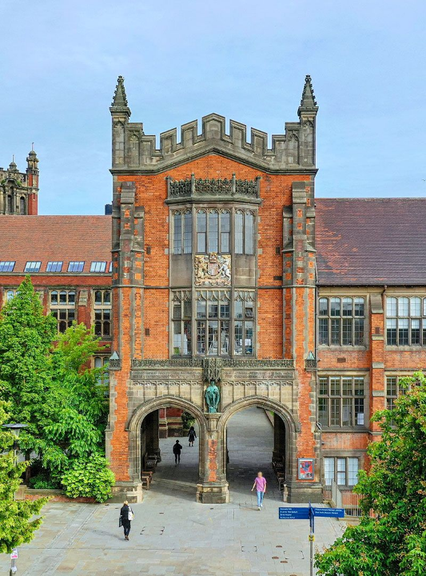
What we’ll cover
• What is the PARTNERS Programme?
• PARTNERS Academic Summer School (PASS)
• Benefits of the Programme
• Eligibility Criteria
• Application Process
• How to find out more
FROM NEWCASTLE. FOR THE WORLD.

Slide 3









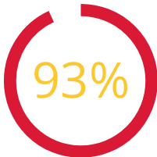









Why Newcastle University?
110
Top
Global World University
Top 5
Student City
QS global top 30 for Sustainability and Social Impact
Founding member of the Russell Group
15th in UK for global research power
Top 10
British University & College Sport
of graduates in a full-time job or further study within 6 months
185+ undergraduate degrees
14 in the world top 100 - 2 in the top 50
Notes:
Note title
Type your notes here. They will be viewable in presenter view.

Slide 4






Our Top Courses
2nd in the UK
3rd in the UK
4th in the UK
Creative Writing
Fine Art
Dentistry
Agriculture
Asian Studies
Communication and Media Studies
Food Science
Top 50 in the world for
GeographyDevelopmental Studies
Top 100 in the world for
Anatomy and Physiology
Archaeology
Architecture
Classics and Ancient History
Dentistry
English Language and Literature
Engineering - Civil and Structural
Environmental Sciences
Geology
Geophysics
Medicine
Pharmacy and Pharmacology
Notes:
Note title
Type your notes here. They will be viewable in presenter view.

Slide 5
What is the
PARTNERS Programme?
FROM NEWCASTLE. FOR THE WORLD.

Slide 6

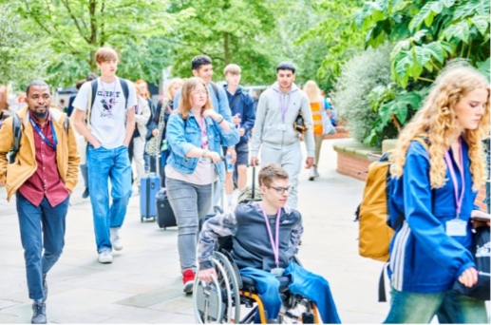
PARTNERS Programme
What is the PARTNERS Programme?
•A supported entry route to Newcastle University
•Over 9000 students have entered via PARTNERS
•1613 students took part in 2022
•Nationally recognised programme
•Has been running since 2000
From Newcastle. For the world.
Notes:
3

Slide 7
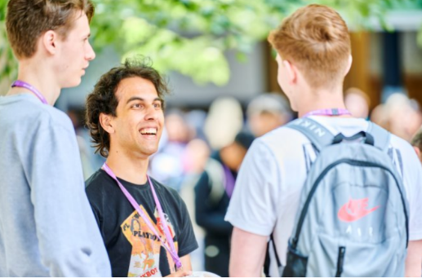
PARTNERS Programme
What is the PARTNERS Programme?
• Receive a lower offer from Newcastle University
• Offer includes successful completion of a free Summer School
• Extra help & support while applying and once at the University
From Newcastle. For the world.
Notes:
4

Slide 8

PARTNERS Programme
What is the Lower Offer?
Up to three grades lower than the typical offer
Medicine 2025 entry:
• Typical offer – AAA at A level
• PARTNERS offer – BBB at A level, plus successful completion of the Summer School
Find the lower offer for the course you’re interested in:
www.ncl.ac.uk/undergraduate/degrees/
From Newcastle. For the world.
Notes:
5

Slide 9
PARTNERS
Academic Summer School
FROM NEWCASTLE. FOR THE WORLD.

Slide 10


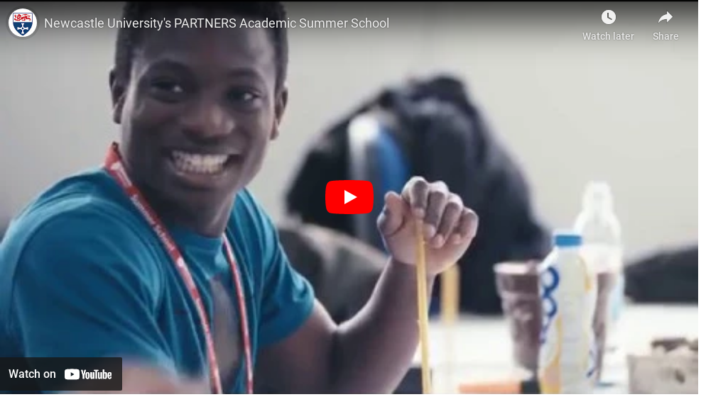
PARTNERS Programme
From Newcastle. For the world.

Slide 11
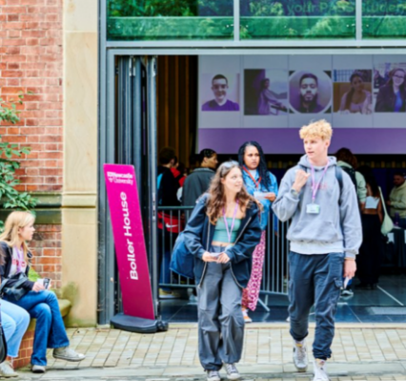
PARTNERS Programme
PARTNERS Academic Summer School (PASS)
An insight into student life – aids the transition between school/college and University
PASS 2025 will take place on the following dates:
• 30 June – 5 July 2025 (TBC)
The event will run partly online and partly on campus at Newcastle University
Completely free to attend
From Newcastle. For the world.
Notes:
8

Slide 12

PARTNERS Programme
PASS – Four Components:
Academic Sessions
Higher Education Skills
Careers & Employability
Social Activities
From Newcastle. For the world.
Notes:
9

Slide 13
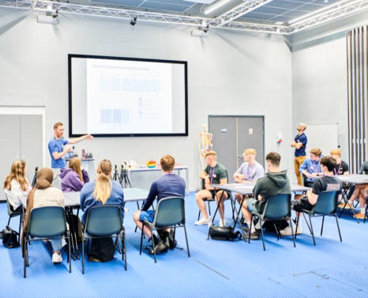
PARTNERS Programme
PASS – Academic Sessions
• Taught by the same lecturers as your undergraduate course
• Subject-specific content, spread across 10-30 academic contact hours
• Over 30 different subject strands
• A range of delivery styles, depending upon what subject you choose to study
From Newcastle. For the world.
Notes:
10

Slide 14

PARTNERS Programme
PASS – Careers & Employability
Raise your awareness of University career services & future options
Recent sessions have included:
•Careers Service Introduction
•Industry Webinars
•How to get the most out of Linkedin
From Newcastle. For the world.
Notes:
11

Slide 15

PARTNERS Programme
PASS – Higher Education Skills
Give you a head-start in preparing for Higher Education.
Recent sessions have included:
•Critical analysis
•Referencing
•Independent study
•How to manage assessments and feedback
From Newcastle. For the world.
Notes:
12

Slide 16

PARTNERS Programme
PASS – Social Activities
It’s not all about hard work! Developed by our dedicated team of student reps.
Activities vary from year to year. Recent sessions have included:
•Cinema Night
•Quiz Night
•Pizza & Games
•City Tours
From Newcastle. For the world.
Notes:
13

Slide 17
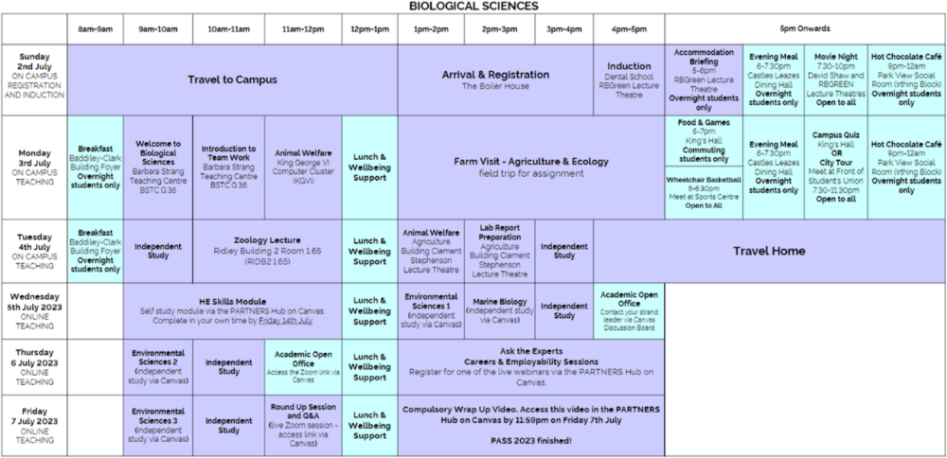
PARTNERS Programme
PASS – Example Timetable 2023
From Newcastle. For the world.
Notes:
14

Slide 18

PARTNERS Programme
From Newcastle. For the world.
Notes:
Note title
Type your notes here. They will be viewable in presenter view.

Slide 19
Benefits
Of The Programme
FROM NEWCASTLE. FOR THE WORLD.

Slide 20

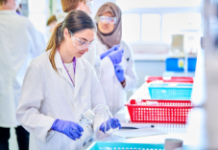



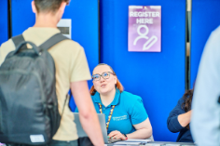


PARTNERS Programme
What’s in it for me?
See what university is really like
Use Newcastle University facilities
Meet other students
Increase your confidence
Enhance your employability skills
Ongoing support from PARTNERS
Receive the lower offer
It’s completely free to attend
From Newcastle. For the world.
Notes:
16

Slide 21
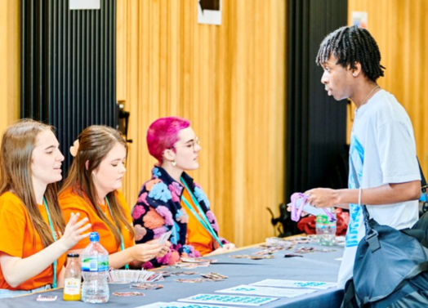
PARTNERS Programme
Ongoing Support
Once you’re at the University:
• PARTNERS mail base
• Work Opportunities – Summer School Reps, FutureMe Mentors, Student Ambassadors
• Focus Groups
• How’s It Going So Far?
• Careers Insights
• Online community to keep in touch with fellow PARTNERS students
From Newcastle. For the world.
Notes:
17

Slide 22
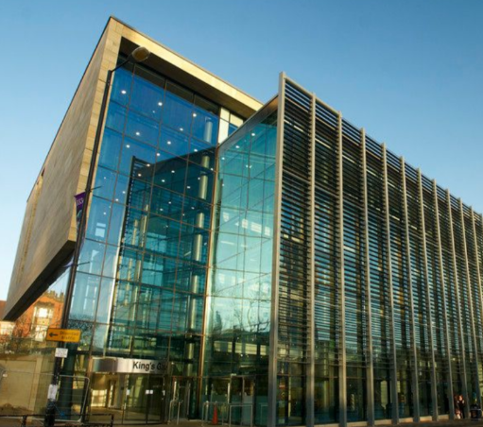
PARTNERS Programme
Financial Support
For 2025 entry, PARTNERS students exclusively
could apply for the following bursaries:
• Charles Letts Scholarship (STEM subjects)
- £2,000 per year
• St Nicholas’ Educational Trust Scholarship
- £1,250 per year (all subjects)
• NUSU Participation Bursary (all subjects)
- £280 per year
From Newcastle. For the world.
Notes:
18

Slide 23
Eligibility Criteria
How to Get Accepted
FROM NEWCASTLE. FOR THE WORLD.

Slide 24



PARTNERS Programme
How to Get Accepted onto PARTNERS
You must:
Meet any 1 (or more) of the 15 eligibility criteria
Make Newcastle University your Firm Choice
Meet all essential conditions
From Newcastle. For the world.
Notes:
20

Slide 25
PARTNERS Programme
Essential Conditions – All Required
Home Student Status
UCAS Deadlines
Resident in the UK
Predicted Grades
From Newcastle. For the world.
Notes:
21

Slide 26


PARTNERS Programme
Essential Conditions – Predicted Grades
Your predicted grades must be:
No more than one grade lower than the lower PARTNERS offer (or equivalent)
To receive an offer from the University, you must also fulfil any other selection criteria, for example: interviews and any specific subject requirements
From Newcastle. For the world.
Notes:
22

Slide 27
PARTNERS Programme
Essential Conditions – Predicted Grades
For example, if you apply to Dentistry (A206):
Typical Offer
AAA at A level (or equivalent)
PARTNERS Offer
BBB at A level
(or equivalent)
Requirement for PARTNERS
BBC at A level
(or equivalent)
For Dentistry (A206), to receive an offer you must also meet other selection criteria - UCAT Score and completion of work experience
From Newcastle. For the world.
Notes:
23

Slide 28

PARTNERS Programme
Eligibility Criteria – One (or more) Required
Additional Financial Support
Your School or College
Parent/Carer Experience
Home Postcode
Disability
Refugees, Asylum Seekers or Humanitarian Protection
Engineering, Maths, Physics, Environmental or Natural Sciences applicant
Black, Asian and Minoritised Ethnic Groups
Gypsy, Roma or Traveler Communities
Military Families
Estranged Students
Experience of Local Authority Care
Personal Extenuating Circumstances
Young Carer
Student Parent
From Newcastle. For the world.
Notes:
24

Slide 29

PARTNERS Programme
Eligibility Criteria – One (or more) Required
Check whether you meet any of the criteria at…
ncl.ac.uk/partners
From Newcastle. For the world.
Notes:
25

Slide 30

PARTNERS Programme
Firm Choice - Required
You must make Newcastle University your
Firm Choice
From Newcastle. For the world.
Notes:
26

Slide 31
How and When to Apply
To the PARTNERS Programme
FROM NEWCASTLE. FOR THE WORLD.

Slide 32



PARTNERS Programme
How to Apply
Submit a separate PARTNERS application form
PARTNERS Team will confirm your eligibility
Submit your UCAS Form
Add a ‘P’ to your UCAS form
and make sure to meet the deadlines!
Available at
ncl.ac.uk/partners
We’ll also notify the admissions team
From Newcastle. For the world.
Notes:
28

Slide 33
PARTNERS Programme
When to Apply
•PARTNERS is open to students in Year 13 or final year of college only
•You can apply to PARTNERS as soon as you have completed your UCAS form
From Newcastle. For the world.
Notes:
29

Slide 34
Thank you!
Find out more: ncl.ac.uk/partners
Contact the team: partners@ncl.ac.uk
FROM NEWCASTLE. FOR THE WORLD.

