Slide 1




Our Guide to Student Finance
Notes:
Type your notes

Slide 2


What we'll cover today
Tuition Fees
Living Costs
Non-Repayable Finance
Applying
Loan Repayment
Notes:
Type your notes

Slide 3

Tuition Fees
Notes:
Type your notes

Slide 4


Tuition Fees
Maximum fee permitted to charge UK/EU students is set by the UK government
2024/25 fees stand at £9,250 .
Notes:
Type your notes

Slide 5




Student support
Where do tuition fees go?
Cutting edge research
World Class facilities
Staff
Infrastructure
Notes:
Type your notes

Slide 6



Tuition Fee Loans
Apply through Student Finance England /Wales/Scotland/NI
Student Finance is a separate organisation to universities
Full-time or part-time students can apply
You can apply to receive the full Tuition Fee Loan (£9,250) or only part of it
Loan goes straight to the University
Notes:
Type your notes

Slide 7
Maintenance Loan
Notes:
Type your notes

Slide 8

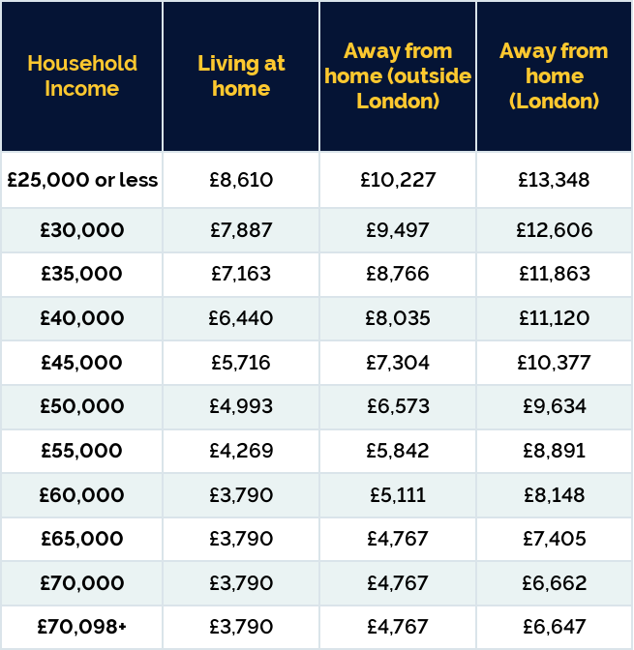
Maintenance Loan for Living Costs
Basic rate of Maintenance loan (£4,767) and then additional is means tested
Apply through Student Finance England
Loan goes straight into your bank account
EU students and students aged 60 and over cannot apply for a Maintenance Loan
Received in three almost equal instalments
Notes:
Type your notes

Slide 9


See how much you may be eligible for
https://www.gov.uk/student-finance-calculator
Notes:
Type your notes

Slide 10




Living Costs
Living costs and spending will differ vastly from person to person
Includes: Rent, Food, socialising, books, travel etc.
Our website has examples of average spend for various categories, let's take a look...
Maintenance
Loans
Bursaries and Extra Help
Notes:
Type your notes

Slide 11










Student spends (per month)
£415 - £775
Uni Accommodation (often including bills)
£108 - £214
Food
£129 - £214
Social and Leisure Activities
£21 - £43
Household Essentials
£11 - £50
Mobile Phone
£13.99+
The Gym
£28 - £68
Local Transport
£7.50 - £11
Contents Insurance
£21 - £64
Personal Care
Notes:
Type your notes

Slide 12

















Retail
Work in the Students' Union
Recruitment Agency
Customer support
Waiting
Jobs On Campus
Student jobs
Bar work
Lots of student choose to work part-time during their time at university.
Lab Assistant
Tutoring
Student Ambassador
Deliveroo/Uber Eats rider
Call centre
Notes:
Note title
Type your notes here. They will be viewable in presenter view.

Slide 13


Budgeting
Understanding the cost of living and budgeting accordingly is an important part of university life.
The average living costs for a student in the UK is around £1000 per month. However, Newcastle is one of the cheapest cities in the UK!
A lot of the living costs associated with student life are typically lower in the UK's northern cities, meaning your money will go further.
It may be that your maintenance loan will not cover all of your living costs.
Top Tip!
For a budget to be effective you need to stick to it!
Notes:
Type your notes

Slide 14

Sharia Funding
From 2025, the government will launch a new type of student loan called 'Alternative Student Finance'. This is an alternative loan which is compatible with Islamic Finance Principles of not engaging with paying interest.
Instead students will repay contributions back to a Takaful fund and these contributions will be used to help future students fund their studies.
For 2024 entry, students can utilise scholarships and grants available at different universities as well as sharia bank accounts.
Al Rayan Bank currently provides bank accounts that comply with Sharia Law
Lloyds also has Islamic Banking where interest fees are not charged for Muslim customers
Notes:
Note title
Type your notes here. They will be viewable in presenter view.

Slide 15
Additional Support
Notes:
Type your notes

Slide 16




Non-Repayable Grants
Special Support Grants
You must be a full time student. Part-time and EU students cannot apply.
You may be eligible if you qualify for: Income Support, Housing Benefit
You may also be eligible if you are a lone parent or have certain disabilities.
You will be told if you are eligible for this grant when you apply for Student Finance
Notes:
Type your notes

Slide 17


Non-Repayable Grants
Special Support Grants
Students with dependents may be eligible for:
Childcare Grant
Parents' Learning Allowance
Adult Dependants Grant
Notes:
Type your notes

Slide 18




Non-Repayable Grants
Course-specific
Course-Specific Support:
Medicine, Dentistry and Health Care students- help with costs of travel to UK clinical placements
Social Work bursaries available
Financial support for teacher training students
If you are going to Study Abroad, you may be entitled to a grant to help cover travel expenses
COMPLETE UNIVERSITY GUIDE WEBSITE
Notes:
Type your notes

Slide 19




Disabled Student Allowance (DSA)
Grant to help with extra costs you might have due to a disability, long-term health condition, mental health condition, or specific learning difficulty e.g. dyslexia, anxiety, autism, ADHD.
DSAs can help to pay for:
Specialist equipment you need for studying, like computer software
Non-medical helpers, for example a note taker or reader
Additional travel costs you may pay as a direct result of your disability
Full-time or part-time students eligible.
Applying for DSA
Top Tips
Notes:
Type your notes

Slide 20


Applying for DSA
Log in to your Student Finance Account and complete DSA 1F Form:
www.gov.uk/studentfinance
2. Get your eligibility notification
3. Book and attend your assessment
4. Get your Entitlement Notification
5. Order equipment & arrange support
before your course starts
Our Top Tips
Apply as early as possible to ensure support is in place for when you start your course.
Applications can take around 14 weeks.
Notes:
Type your notes

Slide 21



Student bank accounts and student
discounts
Students can apply for a student bank account from one bank, and with that they usually offer perks such as an Amazon voucher or railcard.
Most student bank accounts also offer an overdraft at 0% interest.
Check out student discount websites and apps!
Look out for student weeks in your city/university.
Notes:
Type your notes

Slide 22
Applying for
Student Finance
Notes:
Type your notes

Slide 23


When to apply
To get your funding in time for the start of the academic year, you must apply by:
End of May 2024: New (September 2024) students
End of June 2024: Continuing students
Apply at: www.gov.uk/student-finance
Notes:
Type your notes

Slide 24




How to apply
Create an account
Usually, within 6-8 weeks you'll get a loan declaration in the post - sign and return it
Login and complete the online application form
You may be asked to send in proof of identity
Notes:
Type your notes

Slide 25



Household Income
Your parent or carer will need to give information about their income if your student finance is based on their household income
They'll be asked for financial details for the last full tax year prior to the start of the academic year. For example, for the 2024/25 academic year, the tax year will be 2022/23.
If your income in the current tax year is likely to be at least 15% lower than the previous tax year, Student Finance England can assess your household income on what you estimate your income will be.
Notes:
Type your notes

Slide 26



What if your circumstances change?
You must update your application online if your circumstances change. For example:
If you change your course or university through clearing.
Change where you are going to live - for example with your parents instead of halls.
Apply at: www.gov.uk/student-finance
Notes:
Type your notes

Slide 27

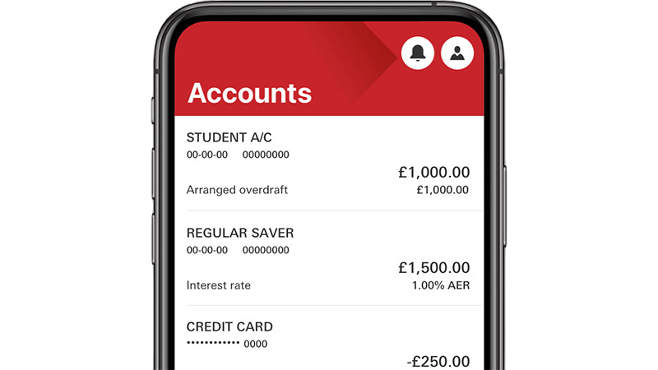
Make sure you can be paid!
After you register at your university or college you'll usually get your maintenance loan paid directly into your bank account at the start of each term.
Use your student finance account to:
update your bank details - for example if you open a student account
check how much you'll be paid
check when you'll be paid
Apply at: www.gov.uk/student-finance
Notes:
Type your notes

Slide 28
Repayment
Notes:
Type your notes

Slide 29





Repayment
Repayment Amounts
E.g. Earn £27,000 a year (£2,250 a month)
That is £167 over the threshold (monthly income)
9% of £167 = £15/month
Pay nothing back until you earn over £25,000 per year (£2,083 a month before tax and other deductions)
Repayment deducted directly from salary at 9% of anything earned over £25,000
Repayment based on what you earn, not what you owe
Written off after 40 years
Interest Rates
You pay interest from the first loan instalment until the loan is paid off in full OR written off
Interest rate is based on the Retail Price Index (RPI)
Notes:
Type your notes

Slide 30
Financial Support at Newcastle
Notes:
Type your notes

Slide 31








Support for Cost of Living
The cost of living is still a huge concern for students throughout the UK. Here are some of the steps Newcastle are taking to support Students.
£1 Meals
Student Financial Support Fund
Free sustainable period products
Careers Service funding to 'Make it Happen'
Give It A Go programme
On campus laundry facilities for all students
Students' Union's free to use Pantry
Money Matters Canvas Course
Notes:
Note title
Type your notes here. They will be viewable in presenter view.

Slide 32





Support at Newcastle
Bursaries and Scholarships
Opportunity scholarship
Subject-specific scholarship
Non-repayable grant from your university
Newcastle University is investing £32 million in its scholarships over the next five years
Check university websites to see what you could be entitled to
Sports scholarship
Sanctuary Scholarship
Notes:
Type your notes

Slide 33



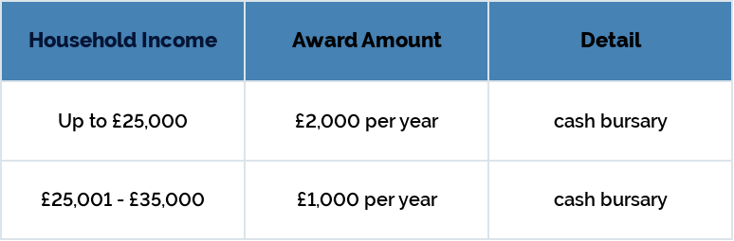




Opportunity Scholarship
In your Student Finance Application, tick the box to share information with your university.
If you're eligible, you will automatically be awarded the scholarship on a termly basis.
Notes:
Type your notes

Slide 34







Subject-specific Scholarship
Subject specific scholarships worth up to £5,000 per year:
Engineering
Mathematics and Statistics
Natural & Environmental Sciences
Physics
Science, Technology, Engineering and Mathematics subjects (STEM)
Music
www.ncl.ac.uk/undergraduate/fees-funding/scholarships-bursaries/
Notes:
Type your notes

Slide 35







Sports Scholarship
Regional/National/International standard within the last 12 months.
Allocated on case-by-case basis: Up to £10,000
Students should be part of a National Governing Body Performance Squad or equivalent.
Email: performance.sport@ncl.ac.uk
Notes:
Type your notes

Slide 36







Sanctuary Scholarship
Applicants can receive full tution fees and living expenses paid for (commences September 2024)
The following categories of applicants can apply under this scheme:
Asylum Seekers
Children of asylum seekers and unaccompanied asylum-seeking children (eg. children migrants under 18)
Applicants with refugee status (ineligible for Student Finance government funding)
www.ncl.ac.uk/undergraduate/fees-funding/scholarships-bursaries/sanctuary/
Notes:
Type your notes

Slide 37







Stay in touch
uk.recruitment@ncl.ac.uk
@NewcastleUni
www.ncl.ac.uk
@UniofNewcastle
Notes:
Type your notes

Slide 38


Tell us what you think..
We'd love to hear what you thought of today's session and in return, you'll be entered into a prize draw to win some Newcastle University branded goodies! Please take a couple of minutes to fill out the form on your desk.
From Newcastle. For the world.
Notes:
Type your notes

Slide 39

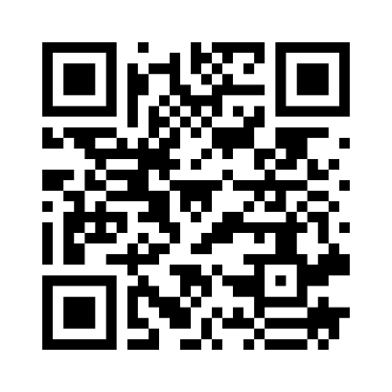

Tell us what you think!
We'd love to hear what you thought of today's session and in return, you'll be entered into a prize draw to win some Newcastle University branded goodies! Please take a couple of minutes to fill out the online form.
From Newcastle. For the world.
Notes:
Type your notes

Slide 40

Thank you for listening.
Any Questions?
Notes:
Type your notes

